Slide 1
Creating Sustainable & Scalable Services
Supporting Digital Humanities in the Library:
Monica McCormick
Jennifer Vinopal
New York University
Digital Library federation forum / 11-1-2011
Monica.mccormick@nyu.edu / vinopal@nyu.edu

Slide 2
Background: Mid 2000s
Digital Library federation forum / 11-1-2011
Monica.mccormick@nyu.edu / vinopal@nyu.edu
Notes:
First, I’ll give you a little background to contextualize our research project. In the mid 2000s…

Slide 3


Background: Mid 2000s
Digital Library federation forum / 11-1-2011
Monica.mccormick@nyu.edu / vinopal@nyu.edu
Notes:
NYU Libraries and NYU Information Technology Services were feeling a certain amount of…

Slide 4




Background: Mid 2000s
Digital Library federation forum / 11-1-2011
Monica.mccormick@nyu.edu / vinopal@nyu.edu
Notes:
frustration because of our conflicting desires to create robust and scalable…

Slide 5
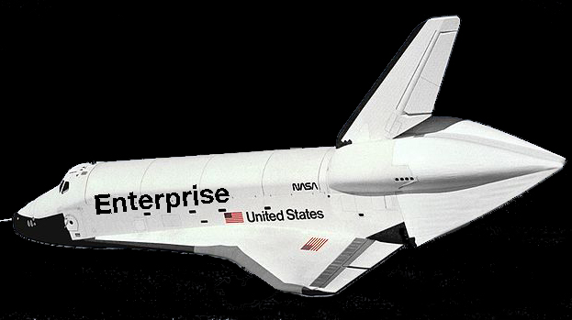
Background: Mid 2000s
Digital Library federation forum / 11-1-2011
Monica.mccormick@nyu.edu / vinopal@nyu.edu
Notes:
enterprise-level, generic tools that would meet the academic and administrative needs of a majority of our tens of thousands of students and faculty, while at the same time…

Slide 6
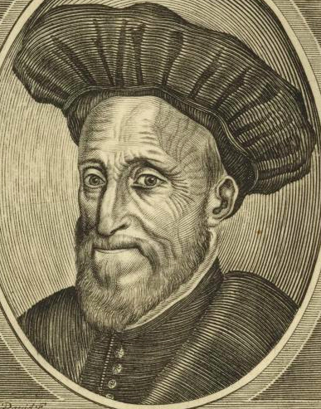
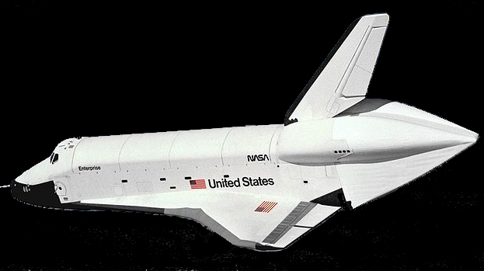
Background: Mid 2000s
Digital Library federation forum / 11-1-2011
Monica.mccormick@nyu.edu / vinopal@nyu.edu
Notes:
Trying to give scholars customized support for their web-based projects.

Slide 7
Digital Library federation forum / 11-1-2011
Monica.mccormick@nyu.edu / vinopal@nyu.edu
Notes:
Like many other research institutions, we rolled out enterprise-level tools…

Slide 8
LMS
Wikis
Email, Calendar
Video Streaming
Shared File Storage
Virtual Computer Lab
Institutional Repository
Digital Library federation forum / 11-1-2011
Monica.mccormick@nyu.edu / vinopal@nyu.edu
Notes:
that are designed to meet the basic academic and administrative needs of a large number of our faculty and students.

Slide 9

Digital Library federation forum / 11-1-2011
Monica.mccormick@nyu.edu / vinopal@nyu.edu
Notes:
But as for scholars needing more customized support…

Slide 10

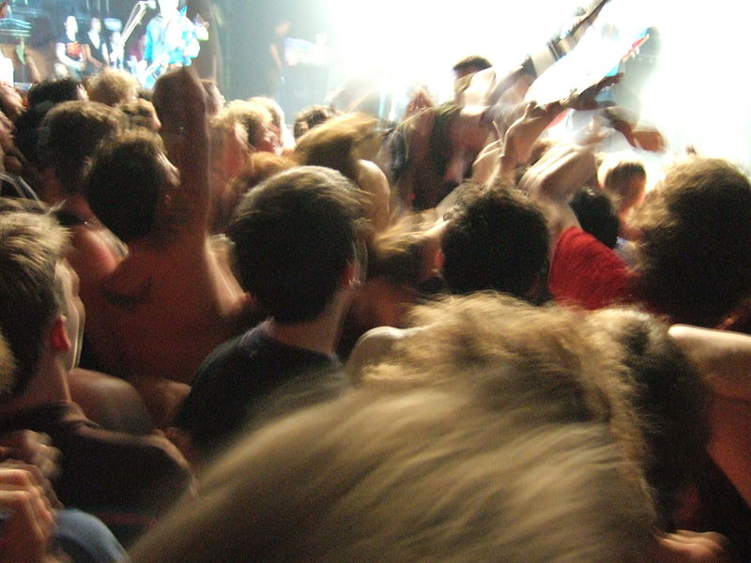
Digital Library federation forum / 11-1-2011
Monica.mccormick@nyu.edu / vinopal@nyu.edu
Notes:
Well, we have lots of diverse faculty needs and requests for custom-built projects. But we are currently responding (if we respond at all) in an uncoordinated and unsustainable way.
[Photo credit: wetwebwork via Flickr, http://www.flickr.com/photos/wetwebwork/141617796/in/photostream/]

Slide 11
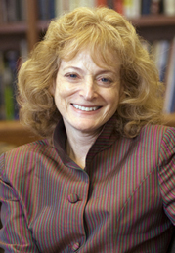
Digital Library federation forum / 11-1-2011
Monica.mccormick@nyu.edu / vinopal@nyu.edu
Notes:
For Carol Mandel, NYU Dean of Libraries, figuring out how to support new web-based forms of collaboration, communication, and publishing is a high-level, strategic priority.
Last spring she asked us Monica and me…

Slide 12
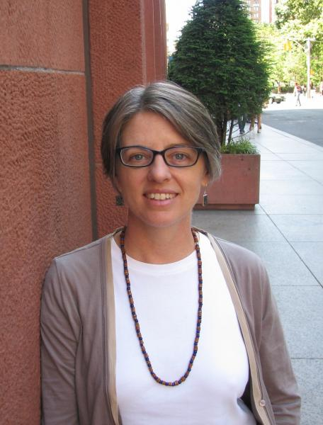
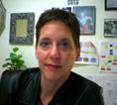
Digital Library federation forum / 11-1-2011
Monica.mccormick@nyu.edu / vinopal@nyu.edu
Notes:
to investigate how such services are offered at other universities and to better define NYU faculty’s needs;

Slide 13
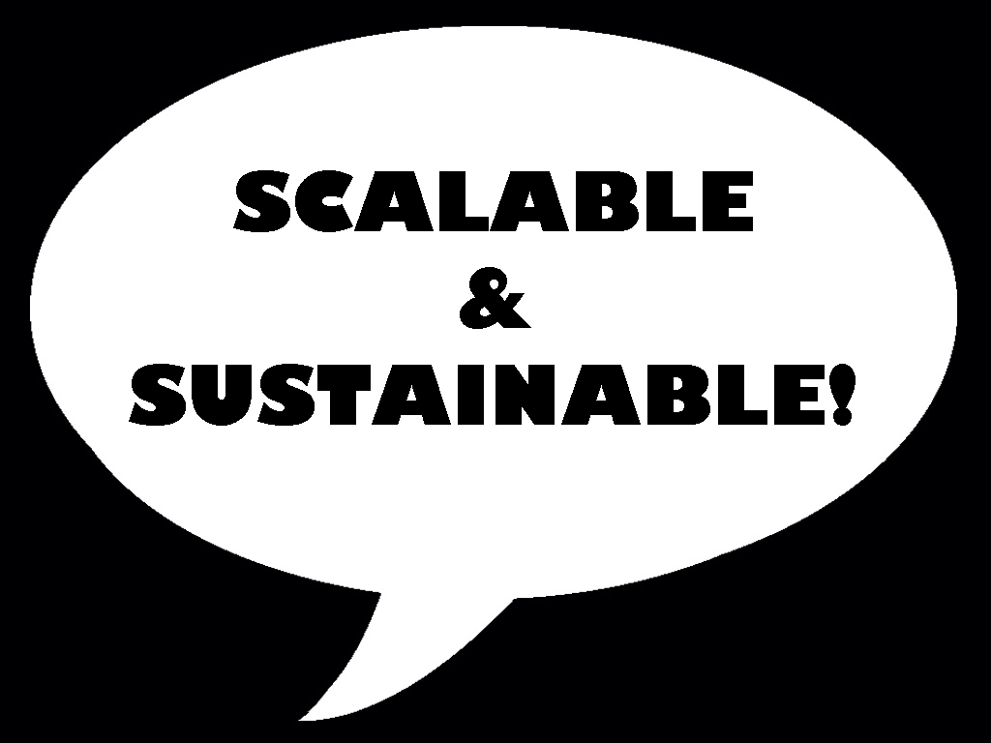
Digital Library federation forum / 11-1-2011
Monica.mccormick@nyu.edu / vinopal@nyu.edu
Notes:
and to then propose a scalable and sustainable service model(s) that might be adopted by NYU Libraries.

Slide 14
Digital Library federation forum / 11-1-2011
Monica.mccormick@nyu.edu / vinopal@nyu.edu
Notes:
So we turned to our peer community as well as to the NYU community for help.

Slide 15






Digital Library federation forum / 11-1-2011
Monica.mccormick@nyu.edu / vinopal@nyu.edu
Notes:
In spring 2011 we started by talking to peer institutions to see how they do it.
These are gross generalizations, but we observed that the organizations we talked to pointed to three general types of service models:
Digital Humanities centers (scholar-driven with a strong R&D component);
Digital research & publishing services (focus on scalability, or first-of-a-kind rather than one-of-a-kind projects); [Thanks to Rebecca Kennison of Columbia for this useful distinction between one-of-a-kind and first-of-a-kind projects)
Orgs that focus on digitizing library collections (library collection driven, focus on building infrastructure)
Again, these are gross generalizations and no single service model I mention here fully describes any of the organizations we spoke to. We’re just pointing to trends.

Slide 16
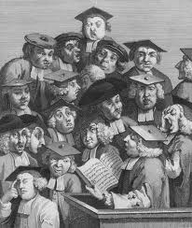
Digital Library federation forum / 11-1-2011
Monica.mccormick@nyu.edu / vinopal@nyu.edu
Notes:
This past summer we partnered with Subject Specialists to identify NYU faculty who are engaged in thinking about or experimenting with technology for their research and publishing.
In October we and the appropriate subject specialists interviewed the faculty.
What do faculty want?

Slide 17
NYU Faculty Want:
Online collaborative workspaces (multimedia, annotation, etc.)
Online exhibits (image, audio, video)
Database-driven websites
Conference websites
Secure working & longterm storage
Video/audio for lectures, projects
Digital Library federation forum / 11-1-2011
Monica.mccormick@nyu.edu / vinopal@nyu.edu
Notes:
Lots of stuff:
But, in a nutshell: they want the university to supply them with programmers to build them websites and lots of storage to manage their stuff.
These are complex demands.
And…

Slide 18
Library
ITS
.EDU Services
Press
DLTS
Digital Pub
Faculty Tech Services
Subject Specialists
Copyright
Digital & Data Studios
NYU Digital Scholarship Support
Digital Library federation forum / 11-1-2011
Monica.mccormick@nyu.edu / vinopal@nyu.edu
Notes:
How could we begin to help them?
Look at our org structure: this is a high-level overview representing Libraries, Press, and campus ITS
It’s a complex service environment.
We have lots of excellent services, some are nascent or under-developed.
But there’s also a lack of integration among these different services. We’re not working in concert.
It’s not only hard for a user to navigate this complex service landscape, but for staff as well.
What we need is a viable service model and to create a shared vision for providing services to support new-model scholarly communication

Slide 19
Digital Library federation forum / 11-1-2011
Monica.mccormick@nyu.edu / vinopal@nyu.edu
Notes:
For the research scholar, what we really want to offer is this…

Slide 20
Org-wide service model
Clear Path To Services
Digital Library federation forum / 11-1-2011
Monica.mccormick@nyu.edu / vinopal@nyu.edu
Notes:
… a clear path to whatever services we *do* currently or will eventually provide.
(Note: the color gradient is meant to represent our vision of NYU Libraries, Press, ITS working together!)
Here are some components of what a *possible* service model might look like (note: NYU has not adopted this model):

Slide 21
Digital Library federation forum / 11-1-2011
Monica.mccormick@nyu.edu / vinopal@nyu.edu
Notes:
As we said before, many basic academic and administrative needs are met by enterprise tools.
But many research needs remain unfulfilled.

Slide 22
Standardized Research Services
Digital Library federation forum / 11-1-2011
Monica.mccormick@nyu.edu / vinopal@nyu.edu
Notes:
Various units -- Digital Library Technology Services, High Performance Computing, Data Service Studio, etc. -- are currently working to create generalizable research tools such as…

Slide 23
Standardized Research Services
• New-model pub. platforms
• Smarter research repositories
• Integration w/ enterprise tools
Digital Library federation forum / 11-1-2011
Monica.mccormick@nyu.edu / vinopal@nyu.edu
Notes:
A more generic and standardized version of the MediaCommons platform that NYU’s DLTS has developed, that could meet scholars’ needs for web-based publishing venues and collaborative community sites;
Smarter repositories, e.g., low-latency, high speed working storage, with a focus on collaboration
Integration of these services with our enterprise tools: e.g., mashup of Dspace + Sakai + grouper
At this point the tools and integration for some services in this category are in development.
However current user support *services* for these tools are pretty much non-existent.

Slide 24
Standardized Research Services
For as Many as Possible
Digital Library federation forum / 11-1-2011
Monica.mccormick@nyu.edu / vinopal@nyu.edu
Notes:
We hope to make these generic research tools, platforms, and user support services as generalizable and scalable as possible and thus available to as many scholars as we can.

Slide 25
Standardized Research Services
For as Many as Possible
“Configured” Standard
Digital Library federation forum / 11-1-2011
Monica.mccormick@nyu.edu / vinopal@nyu.edu
Notes:
A second tier of service: would include the ability to provide some custom configuration of the *standardized* research services. (Note that these proposed service levels are all interlinked and build on each other)

Slide 26
Standardized Research Services
For as Many as Possible
“Configured” Standard
• Skinning
• Special DMD
• Bulk load & process
Digital Library federation forum / 11-1-2011
Monica.mccormick@nyu.edu / vinopal@nyu.edu
Notes:
Configuration options for standardized services might include:
Skinning the user interface to a standard tool in order to make it *look* customized,
providing a more custom-tailored DMD input interface to a repository (rather than using the out-of-the-box DMD input configuration)
Having a staff member with special skills do bulk uploads, metadata transformations, or special processing of a scholar’s collection.
We’re already doing some of this, for example, for select collections going into our Institutional Repository.

Slide 27
Standardized Research Services
For as Many as Possible
“Configured” Standard
Selective
Digital Library federation forum / 11-1-2011
Monica.mccormick@nyu.edu / vinopal@nyu.edu
Notes:
Though the goal would always be to help as many scholars as possible, access to this level of service, requiring more staff time & support, would be more selective.
Depending on demand, we may need to develop a process for evaluating and selecting among proposed projects, or follow Columbia U’s CDRS’s lead and develop a for-fee model.

Slide 28
Standardized Research Services
For as Many as Possible
“Configured” Standard
Selective
Applied R&D
Digital Library federation forum / 11-1-2011
Monica.mccormick@nyu.edu / vinopal@nyu.edu
Notes:
The 4th service category – Applied R&D -- would build on our Digital Library Technology Service’s R&D activities, as well as other development initiatives at NYU Libraries and ITS.

Slide 29
Standardized Research Services
For as Many as Possible
“Configured” Standard
Selective
Applied R&D
• Experimental
• Future research value?
• First-of-kind?
Digital Library federation forum / 11-1-2011
Monica.mccormick@nyu.edu / vinopal@nyu.edu
Notes:
This work is more experimental and focused on developing methods and infrastructure with possible (but not certain) future research value.
This work would hopefully lead to reusable products or integration among existing tools.
The products developed ideally would then be rolled out as “Standardized Research Services”, thereby completing the development and roll-out loop in this model.

Slide 30
Standardized Research Services
For as Many as Possible
“Configured” Standard
Selective
Applied R&D
e.g., Open Annotation
Digital Library federation forum / 11-1-2011
Monica.mccormick@nyu.edu / vinopal@nyu.edu
Notes:
One example: the Open Annotation Collaboration project that DLTS is working on with the University of MD, U of Illinois, LANL, U of Queensland.
Another example: The Media Commons platform that NYU created, which started as R&D and which we hope will eventually become a standardized research service.

Slide 31
Standardized Research Services
For as Many as Possible
“Configured” Standard
Selective
Applied R&D
Highly Selective
Digital Library federation forum / 11-1-2011
Monica.mccormick@nyu.edu / vinopal@nyu.edu
Notes:
Obviously this work is highly selective, mostly grant-funded, and extremely staff intensive.

Slide 32
Library
ITS
.EDU Services
Press
DLTS
Digital Pub
Faculty Tech Services
Subject Specialists
Copyright
Digital & Data Studios
NYU Digital Scholarship Support
Digital Library federation forum / 11-1-2011
Monica.mccormick@nyu.edu / vinopal@nyu.edu
Notes:
For Monica and me: Our current project goal is to devise and propose a way to conceptualize and describe this potential suite of research services…
And eventually help to make our current complex, multi-dimentional, and disaggregated organization…

Slide 33
T
E
C
H
N
O
L
O
G
I
E
S
PUBLIC SERVICE
Digital Scholarship Services
Digital Library federation forum / 11-1-2011
Monica.mccormick@nyu.edu / vinopal@nyu.edu
Notes:
…look more like this from the user’s perspective.

Slide 34
T
E
C
H
N
O
L
O
G
I
E
S
Copyright
Digital Pub
Subject Specialists
Digital & Data Studios
DLTS
Digital Scholarship Services
ITS
Digital Library federation forum / 11-1-2011
Monica.mccormick@nyu.edu / vinopal@nyu.edu
Notes:
With our various units working in unison, with a shared vision, to create a coherent public service.
We believe the biggest challenge to realizing this vision is organizational…

Slide 35
Organizational Challenges:
Create shared vision.
Develop staff knowledge/skills.
Develop prioritization process.
Maintain shared priorities.
VIP projects that don’t fit service model?
Leadership role on campus?
Digital Library federation forum / 11-1-2011
Monica.mccormick@nyu.edu / vinopal@nyu.edu
Notes:
We’ll leave you with a list of what we think would be our biggest challenges in realizing this potential service model.

Slide 36
Thank you
Monica McCormick
monica.mccormick@nyu.edu
Jennifer Vinopal
vinopal@nyu.edu
Digital Library federation forum / 11-1-2011
Monica.mccormick@nyu.edu / vinopal@nyu.edu

