Slide 1
Digital Humanities, Western Europe, and the DiRT Directory
Zach Coble
Digital Scholarship Specialist
New York University

Slide 2
A major Digital Humanities project that focuses on German literature, history and culture and that publishes largely in German will have a difficult time exerting influence within an international Digital Humanities community insofar as that community uses English as a lingua franca.
Gregory Crane
The Big Humanities, National Identity and the Digital Humanities in Germany

Slide 3
The Anglophone community can get away with focusing on projects that focus on the national interests of their various countries -- if they produce interesting technology and do interesting work on English literature, many people in the international DH community can readily follow the English publications, documentation and even commented source code (where source is properly documented). But where 77% of the 55 million records in Elsevier's Scopus database of Arts and Humanities publications point to English language publication, only 4.2% of the records point to German (French, with 7.1% is the second most widely used language, an order magnitude less than English).
Gregory Crane
The Big Humanities, National Identity and the Digital Humanities in Germany

Slide 4
The German DH community needs to decide how it balances its obligation to advance the cultural identity of the German speaking world against its aspiration to participate within, and have an impact upon, the international Digital Humanities community.
Gregory Crane
The Big Humanities, National Identity and the Digital Humanities in Germany

Slide 5

dirtdirectory.org
formerly BambooDiRT
Notes:
walkthrough of the DiRT interface
TaDirah
Organizational history

Slide 6
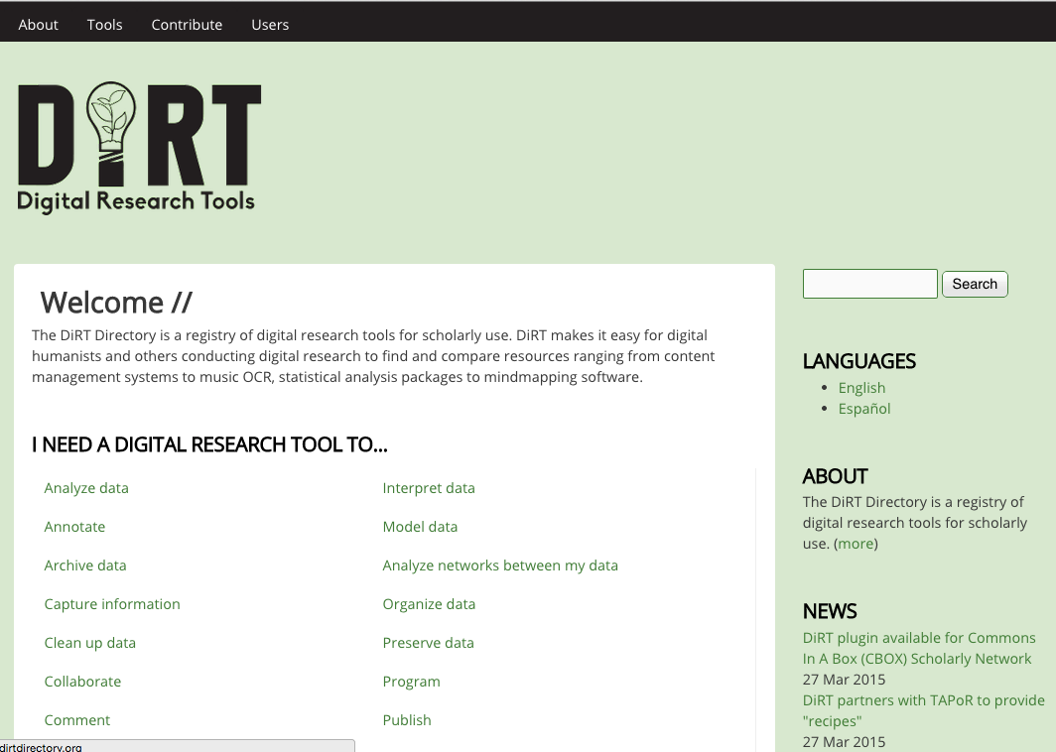
Notes:
how to find Zotero —> human readable —> directory; also show off search

Slide 7
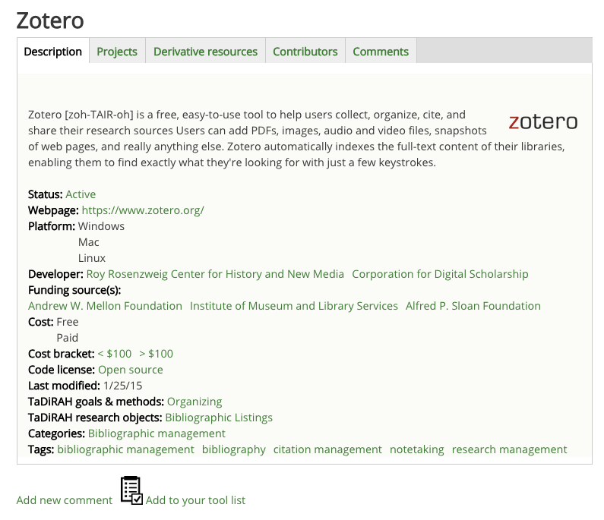

Slide 8
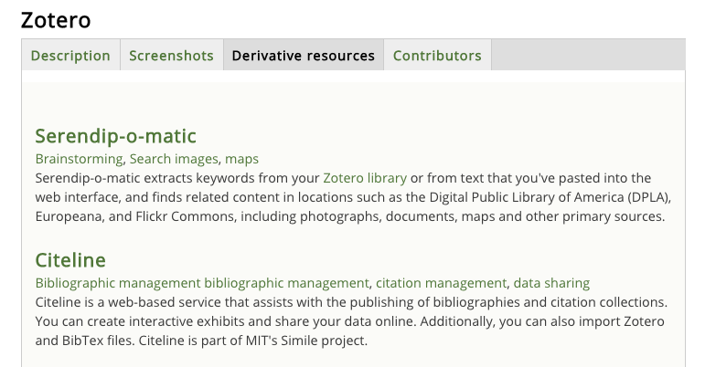
Derivative Resources
Notes:
depends on tab - check the Serendip-o-matic
currently listed as comments, will have new content type for tips, tricks, reviews
revisions tab
also discuss the human readable categories and the filters

Slide 9
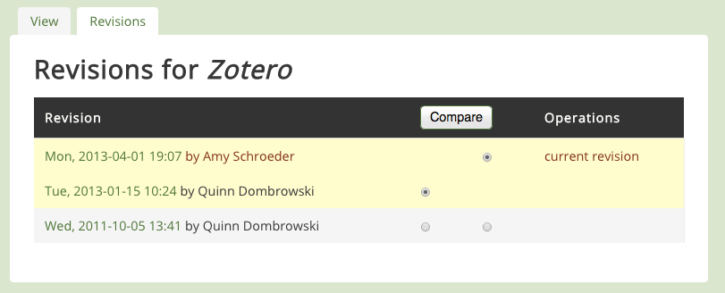
Revisions
Notes:
depends on tab - check the Serendip-o-matic
currently listed as comments, will have new content type for tips, tricks, reviews
revisions tab
also discuss the human readable categories and the filters

Slide 10
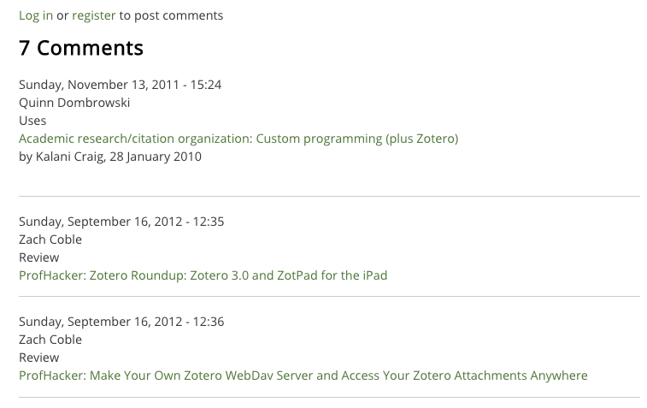
Reviews / Comments
Notes:
depends on tab - check the Serendip-o-matic
currently listed as comments, will have new content type for tips, tricks, reviews
revisions tab
also discuss the human readable categories and the filters

Slide 11
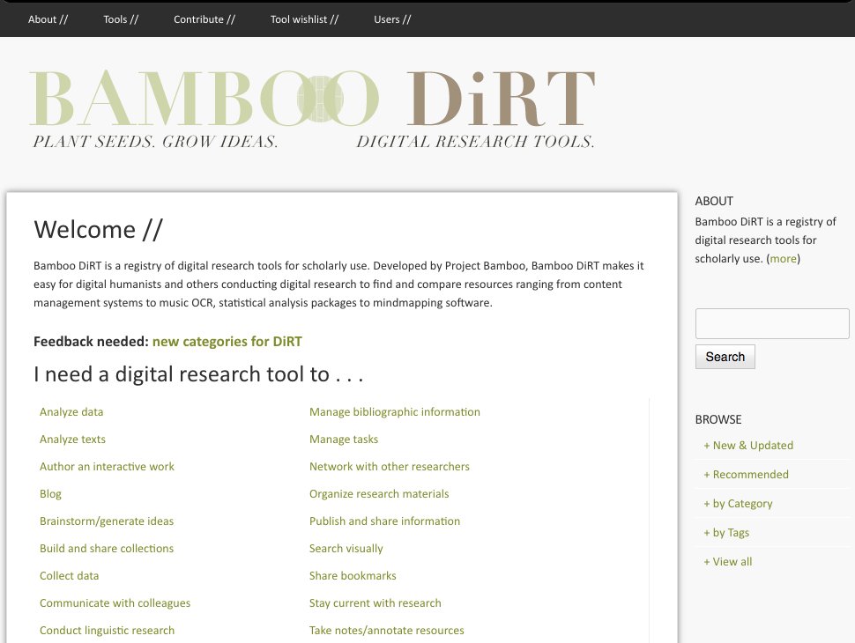
History

Slide 12




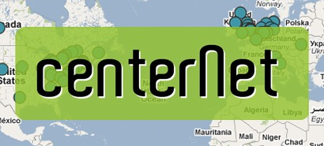

Finding a Home for DiRT
Research IT at
Notes:
Individual —> project / initiative —> institutional —> organizational base
How do projects survive staffing turnover or redirected institutional priorities?
-
commitment to its continued existence
staff time priorities
funding streams

Slide 13
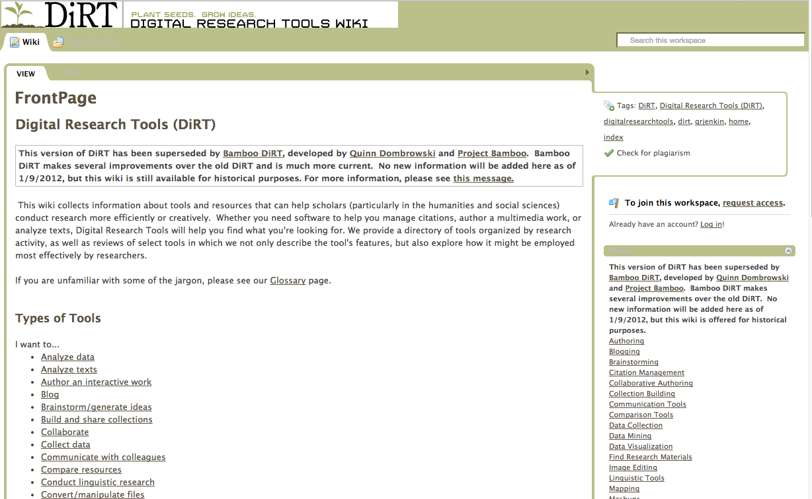
DiRT Wiki (pbwiki, 2008 - 2011)
Notes:
wiki format lagging towards the end of that period, well known but low contribution
Lisa Spiro took on a new role in a new organization
bamboo…why did they choose DiRT; personal connections
good community karma by taking on DiRT; Bamboo’s PR problems
new metadata schema developed during the bamboo period
pull up old tool profiles vs. new tool profiles

Slide 15
Bamboo DiRT: 2011-2013
Project Bamboo: a cyberinfrastructure project funded by the Mellon Foundation and granted to UC Berkeley and UChicago
Migration to Drupal CMS
Manual extraction and expansion of tool entries, more metadata by student employees
Steering Committee appointed
See: “Whatever Happened to Project Bamboo?”, Dombrowski 2014

Slide 16
Who works on DiRT?
Notes:
Project Bamboo provided funds for vastly expanding the original data set, but who continues to grow and maintain the data set?

Slide 17










Steering Committee
Notes:
International volunteer committee, many of whom were early contributors to the DiRT wiki. Many were approached during the Bamboo phase — usage statistics found that a many contributions came from users making many updates at once.
DiRT wiki days — lots of librarians
worked with other orgs to develop the TaDiRAH taxonomy
develop curriculum
manage editors

Slide 18
2014: Spanish Translators
Team:
  Gimena del Rio, lead translator (CAICYT)
  Magdalena Biota (CAICYT)
  Virginia Brussa (CAICYT)
  Beatriz Garrido (LINHD)
enabled via Drupal’s Entity Translation module
metadata is already translated, team is working on tool descriptions
Notes:
Translation informed by Drupal

Slide 19
Integrations in the DH Community
Notes:
had to choose 30 out of 50+

Slide 20


TaDiRAH:
Common Taxonomy & LOD
Taxonomy of Digital Research Activities in the Humanities
Sources:
  the arts-humanities.net taxonomy of DH projects, tools, centers, and other resources, especially as it has been expanded by digital.humanities@oxford in the UK and DRAPIer in Ireland
  the categories and tags originally used by DiRT
  the DARIAH ‘Doing Digital Humanities’ Zotero bibliography of literature on all facets of DH.
Notes:
http://acrl.ala.org/dh/2014/05/21/tadirah-building-capacity-integrated-access/

Slide 21
TaDiRAH: Activities
1 - Capture
2 - Creation
3 - Enrichment
4 - Analysis
5 - Interpretation
6 - Storage
7 - Dissemination
Notes:
expand out to 2nd level categories
goals and methods are a closed list
objects and techniques are open lists
period of public feedback, over 100 comments; double check DHQ article

Slide 22
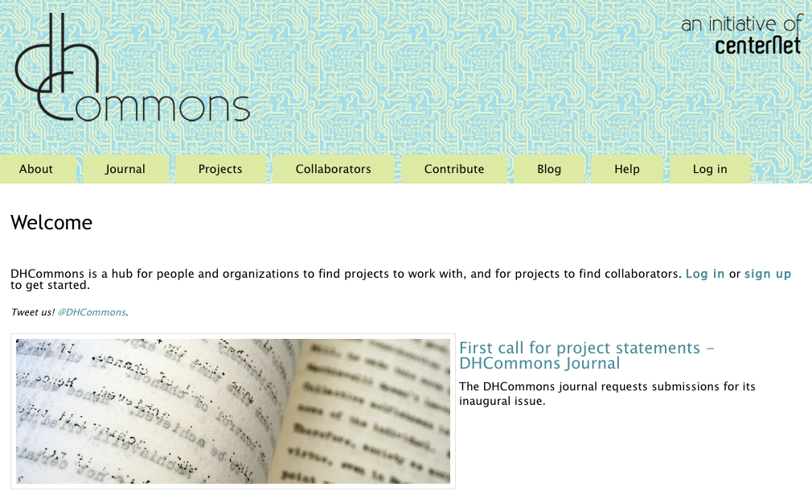
API Integration:DHCommons

Slide 23
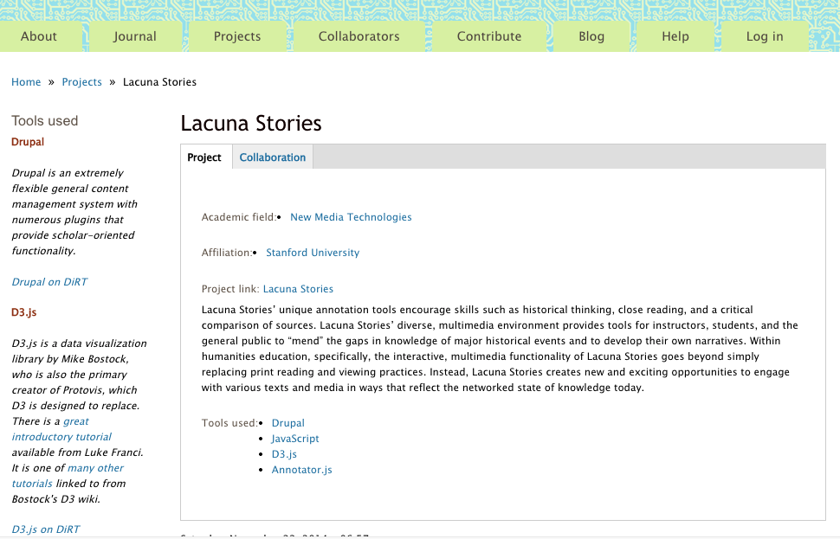
API Integration:DHCommons

Slide 24
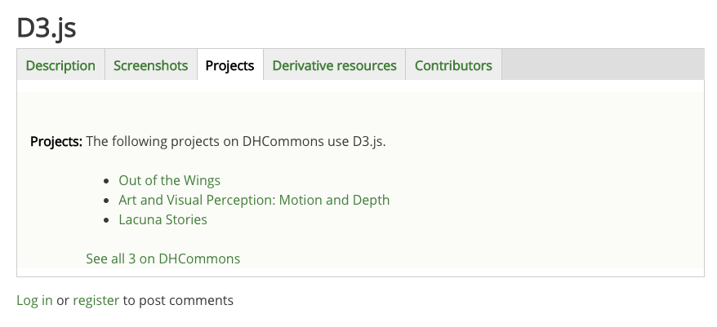
API Integration:DHCommons

Slide 25
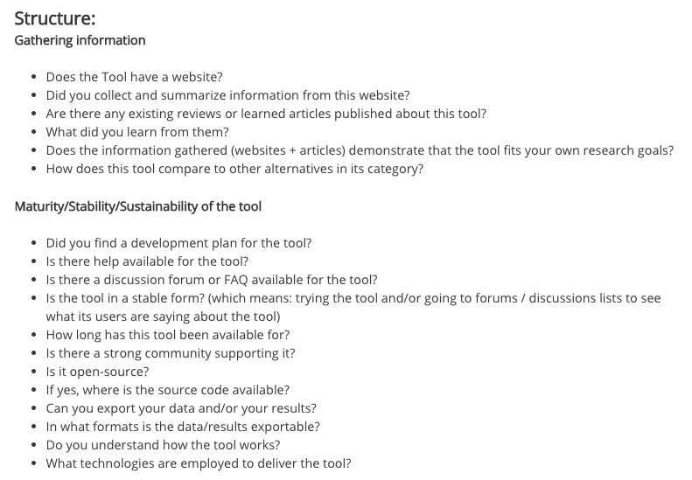
  DiRT Assignment-in-a-Box

