Slide 1


Everyday Assessment and Workflow Management in Access Services via Tableau
Kristina Rose, Head, Access Services, NYU Libraries
Beth Daniel Lindsay, Librarian for Access Services & Instruction, NYU Abu Dhabi
Notes:
Kristina: I’m Kristina Rose, Thank you to Brad and Elois for hosting us today. I’m based in New York City. Over to Beth.
Beth: I’m Beth Daniel Lindsay, Librarian for Access Services and Instruction at NYU Abu Dhabi in the United Arab Emirates. It’s 8PM here, so please be kind.

Slide 2
Overview
NYU Context
Assessment in Access Services
NYU’s Approach
Why Tableau?
Use Cases
Getting started & other considerations
Notes:
Beth
This is our plan for today’s presentation. We’ll describe NYU’s context, including how assessment works here, why we use Tableau, discuss some use cases, and finally provide you with tips on getting started and discuss our future directions.

Slide 3

World map of all NYU locations
Notes:
Our work on everyday assessment is shaped by our environment. As you can see from our locations, NYU is a complex institution. NYU Libraries includes 3 degree-granting campuses in yellow: NY, AD and Shanghai. We deliver library materials to all three plus 11 academic centers on six continents. NYU is truly a global network.
Each campus has a full library but NYU in New York City is responsible for delivery & resource sharing for all. NYC also coordinates ILS management and assessment, although NYU Libraries does not have an assessment department or assessment librarian. Responsibility for assessment is dispersed.

Slide 4
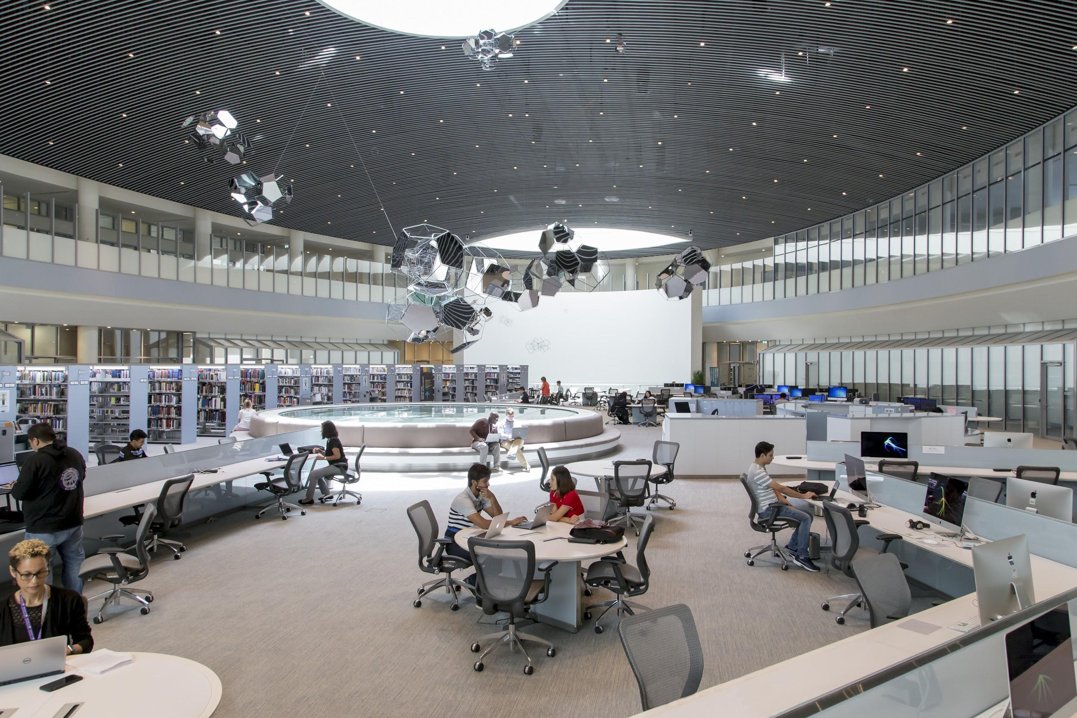
Who we are (just pics?)
NYUAD Library
Notes:
This is a picture of the NYUAD Library to give you an idea of our context. It’s a small library, only 60,000 print materials, but we have access to all of NYU’s circulating collection as well as numerous eresources. I’m actually in this picture at the very back.

Slide 5
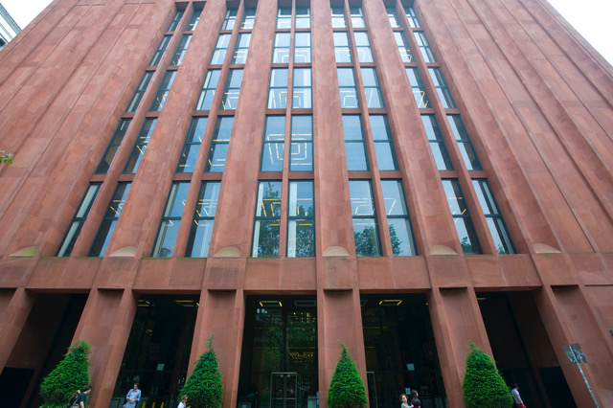

Who we are (just pics?)
NYU Bobst Library
Notes:
Here you see images of Bobst Library, the main library in New York. Bobst has houses 1.5 million volumes onsite and NYU Libraries has over 4 million circulating items.
Access Services at NYU is fairly typical, except that each campus has its own access services unit. As mentioned, we don’t have a dedicated assessment unit and until fairly recently most assessment was done in NYC for either annual reports or upon request.
Access Services at NYU
Circulation
Course reserves
Library access
Onsite & remote stacks
Delivery services
Resource sharing
Space management

Slide 6
Strategic Goal
Become a data-aware organization that promotes open exploration of data and grounds our decisions in evidence.
Notes:
Finally, this our approach to assessment comes directly from our 2013-17 strategic plan which had a goal of becoming a data-aware organization…

Slide 7

Who are you?
Do you have different units or branches in your library/libraries?
Have you needed to make a case to your administration that you need more support ($$$) in your department?
Are you using Tableau?
Notes:
Now you’ve heard a little about us, we thought we’d find out more about you. Please answer these questions as the polls open. The anonymous results will be shared with everyone on the call just to give us a sense of the “room.”
Over to Kristina.

Slide 8
Observations
Access services personnel may be time-stressed and may not have deep assessment expertise.
Notes:
Kristina
Beth talked about the environmental factors shaping our work on everyday assessment. I’m going highlight some of our observations about the need for everyday assessment based on our experience and Access Services literature.
Access services personnel may be time-stressed and may not have deep assessment expertise.
This is due to variety in our jobs. If you glance at any “textbook” on Access Services - and I only know of one - you’ll note the huge number of hats many of us wear. Assessment is only one of our many of our duties. We manage many different types of services and are expected to service many different functions - marketing/outreach, management, workflow innovation, staffing a desk due to a flu-outbreak… the list is endless.
Also, and I am speaking for myself here - I don’t have formal training in data analysis or visualization. Before we implemented our “everyday assessment” approach - I did assessment about once a year during annual report season. I’d pull together several different sources of data from at least 4-5 different systems. In some cases, system analyst created reports for me and emailed the results. I’d pull those into Excel for analysis. If I had a new question or needed to make a change to the analysis, I’d have to start of over with a fresh report. It was a time-consuming and frustrating process - and fraught with errors.

Slide 9
Observations
Quantitative data analysis is the “low hanging” fruit of assessment but the data is often messy & hard to get
Notes:
Quantitative data analysis is the “low hanging” fruit
Quantitative data can support day-to-day workflows and decision-making more easily and quickly than longer term, more substantive qualitative studies. For example, knowing how many people typically use your service point on Mondays in May can help schedule staff. “Seeing” the peaks and valleys of services can be the first step in asking more substantive questions.
Data is often messy & hard to get
The data needed can require a great deal of clean up to actually use. And there are so many different data sources that would be helpful for Access Services..- circulation systems, study room reservation systems, resource sharing and on. Several recent articles/talks about using Tableau for assessment in both Access Services and other contexts note challenges in data-wrangling activities (locating, understanding, normalizing)
In the literature about Access Services, I noticed many of us many of us engage in one-time intensive assessment efforts, when developing services, or making changes but I didn’t find much discussion about ongoing or everyday assessment efforts/models.
What’s a structure that will allow us to be data-informed and make decision based on evidence, easily and sustainably?

Slide 10
Observations
Data promotes understanding & can support change initiatives
Notes:
This final assumption comes from a couple different projects profiled in access services literature which found enabling everyone to see and explore analysis themselves helped support change initiatives. The entire Tableau Public Community is based on the concept of sharing analysis openly, allowing others to explore it for themselves, with their own questions. People don’t make changes based on data alone but making the invisible, visible -- i.e. volume of books going back to shelves; or number of checkouts on Mondays in May…can start a conversation and may be a tool in change management efforts.

Slide 11
NYU’s Approach
Single stop shop: Libraries Data Warehouse
ILS: Circulation & Reserves
Resource sharing
Remote storage
Room Reservation
Bookstore orders
Workflow tools: inventory scanning
Paired with Tableau Desktop
Notes:
NYU’s approach to everyday assessment is based on two tools.
First, we have a data warehouse. It’s a single source for include: our ILS, ILLiad, Relais, our remote storage system, Bookstore and various workflow-related systems, for example the program we use for inventory shelf-scanning. Data is automatically updated from many of these systems on a nightly basis.
Data Warehouse is managed by a team of analysts located in our technical services unit. If you want more information about how our warehouse works, I’ve shared a citation for a presentation about it. I’d also be happy to put you in touch with our team. They’ve made much of what you’ll see today possible.
If you don’t have a warehouse, don’t hang up!. A lot of what will show today, is possible using reports downloaded from your systems and free versions of Tableau.
The second part of our approach: We pair the library warehouse with Tableau Desktop, a licensed software, Access Services can access the LDW via Tableau…but there are many other ways used by our more technically inclined staff.

Slide 12

Why Tableau
Non-replication of effort
Data exploration
Superior filtering
Pre-set visualizations
Easy to learn to the basics
Notes:
This image says it all. This is Ron Popeil, who had this infomercial years ago about this rotisserie oven, just set it and forget it. Tableau is like that.
Let us count the ways….
Non-replication of effort
For example, if you’ve taken the time to “translate” data from your circ system to usable categories… you only have to do that once. We did this for patron categories
Data exploration: Supports not knowing the answer at the beginning.
Superior filtering
Easier to see categories of data than Excel filters
Particularly great for dates.
Pre-set visualizations
Everything we are going to show you today, uses the pre-set visualizations. The principle of everyday assessment means you don’t need to be brilliant, you just need to be able to “see” data that will inform effort.
Easy to learn to the basics. More complex analysis requires significant time
SHOW EXAMPLE

Slide 13
Case Study: Copy Card Fill Stations
Lived Experience
“Copycard recharge stations are always down”
Question
Really? When and how often? Where does this fall in our priorities?

Slide 14
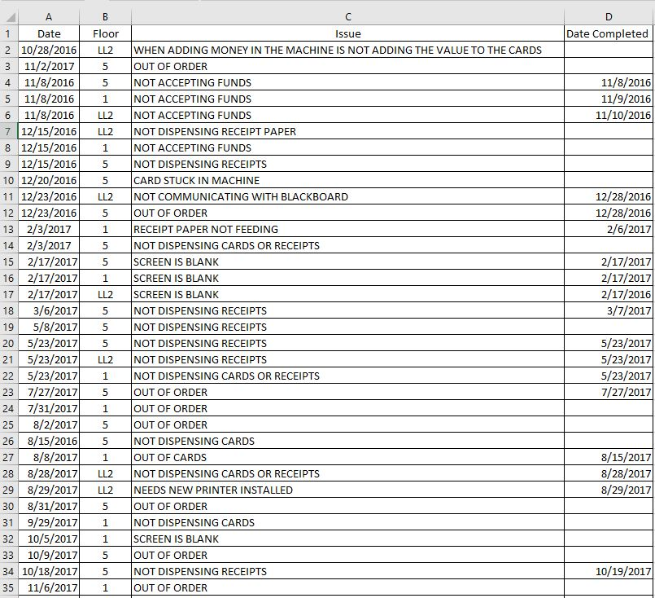
Original File: Excel

Slide 15
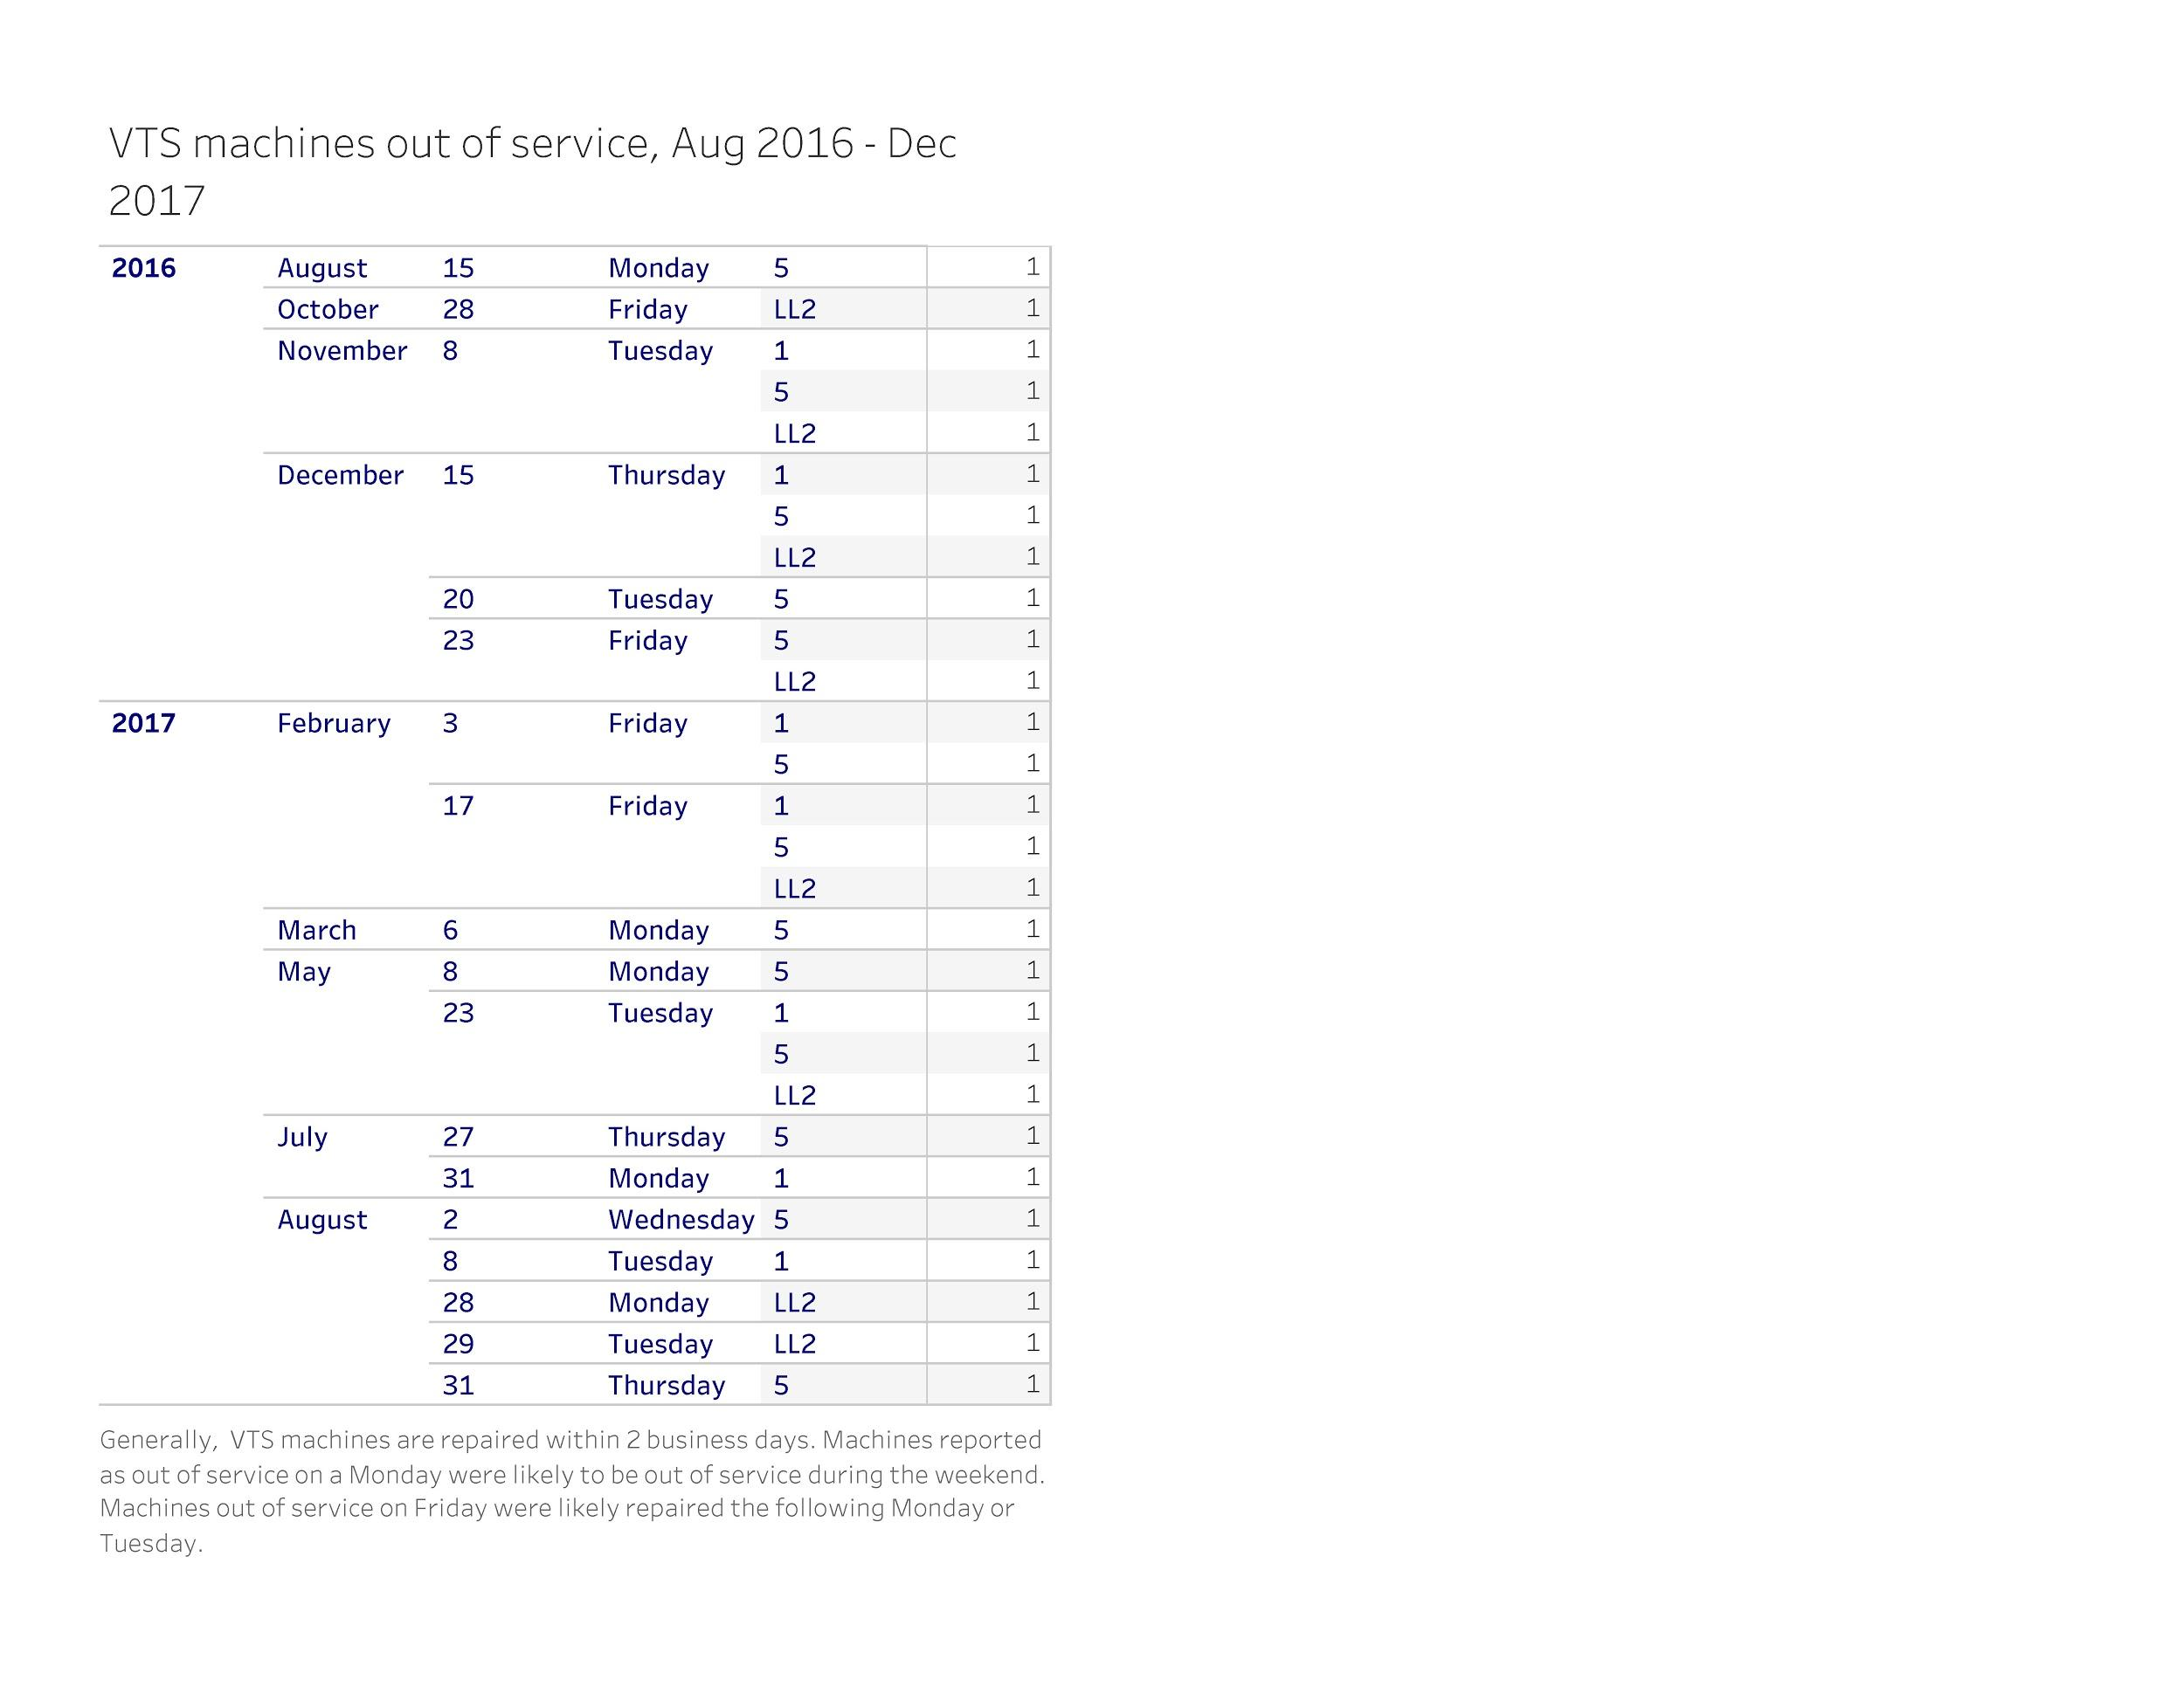
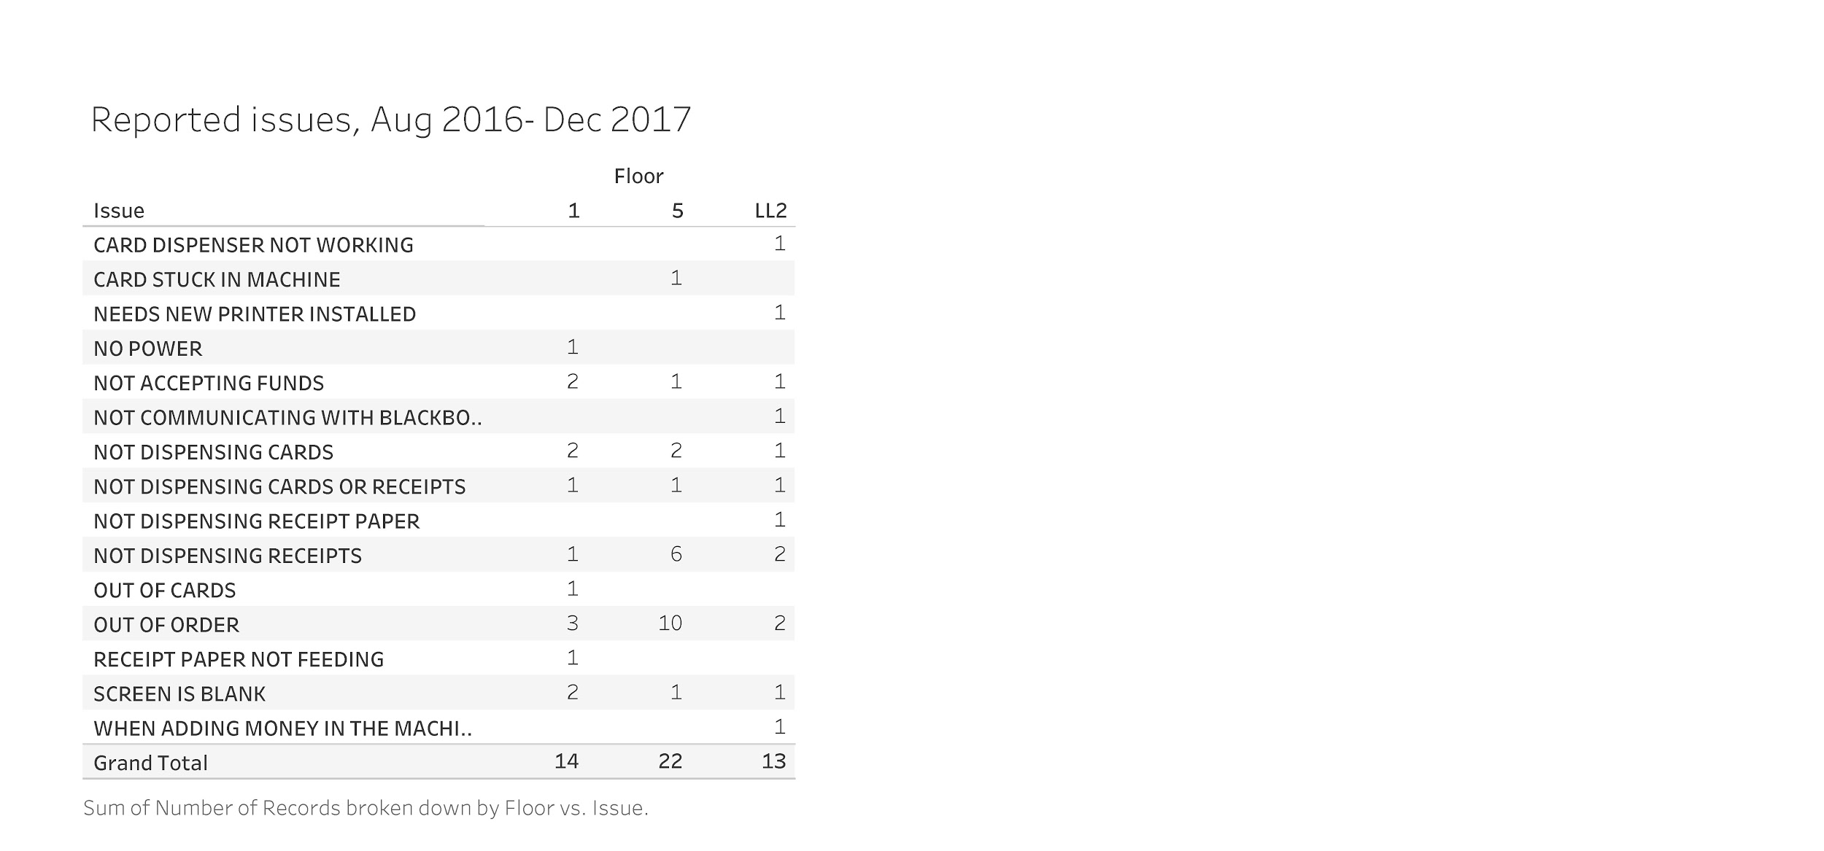
Speedy analysis in Tableau

Slide 16
Which case studies should we discuss?
Policy analysis (late fines)
Space usage based on headcount data
Service desk hours, for changing hours and staffing levels
Collections maintenance
Annual reporting
Usage across services (our collection, E-ZBorrow, ILL)
Notes:
We have more examples than time so we’d like to be sure that we start with the cases that you think are most interesting. Please vote for the case study that you think sounds most interesting based on the title.

Slide 17
Case study: policy assessment
Lived Experience
NYU Abu Dhabi implemented blocks, then fines for users who return equipment late.
Questions
Do users return items on time more often after penalties?
Notes:
Our students were complaining that equipment was “never” available because people “always” kept them out longer than they were supposed to. In the summer of 2014, we implemented blocks (you can’t see this on the visualization, but just for background). There was a small decrease in the percentage of items returned late. In January of 2017, we implemented fines for late return of equipment, again at student request. As you can see now that I’ve told you the break point, far fewer items were returned late after the implementation of this policy, about 10% fewer per month. The difference is even more striking when you view students only -- the difference is about half as many items returned late. So, the policy works.

Slide 18
Case study: space usage
Lived Experience
NYU Abu Dhabi moved campus in 2014. The new library is several times larger than the old library and has very different use patterns. Additionally, administrators visit the library in the mornings and see a large, empty space and suggest allocating space to other departments.
Questions
When are users using the library? Which parts of the library are most popular? How popular are the group study rooms?
Notes:
NYU Abu Dhabi moved from a small, temporary campus to a much larger campus in 2014. After things settled, we started to conduct daily user counts every two hours to better understand how people were using the space. (I’ve written about this in the Journal of Access Services if anyone is interested in how we do this.) After two years, we decided to still count everyday, but only four times per day. I believe that next Academic year we’ll move to sampling weeks.
Anyway, this data has been tremendously helpful because there is a space shortage on campus. Administrators come in the library in the morning and see empty seats that they think could be put to good use, especially the group study rooms. The headcount data shows that the library is busiest after 8 PM, when administrators are not present to see the traffic, and that group study rooms, especially the single-person study rooms, are popular. This data would probably be even better if I changed it to percentage occupied but it seems to have gotten the point across for now.

Slide 19
Case study: Library service desk hours
Lived Experience
“No one is ever here at 9 AM! Can we open the desk later in the summer?”
Questions
Is that true? Is it true for most days of the week or just Friday? If we change hours who will suffer?
Notes:
This suite of visualizations is one of the most consistently useful I’ve created.
Heatmap: This first viz answers the question: who will suffer by mapping usage by user for each hour. Users are ranked by total checkouts per day. You can change the time period and library. Examples:
2014 + June + weekdays: faculty major users but use is small. trimmed hours based
2014+ April + weekdays: undergrads primary users.
The hover feature allows you to see the actual count for a particular time period.
Average circulation by time and day: This helps answer questions about staff levels during specific hours/month/year.
Circulation by month/day/hour: This helps know the total not just average. It also shows the portion of self-check circulation each hour. NOTE: at 10 AM high self-check because we have fewer staff at desk. This helped understand total potential volume when we consolidated our circ-reserves desk in summer of 2015.
Total circulation by date and hour: This view allows you to see circ by hour for a single day or small time period, i.e. a week. We use this to help shape hours intersession hours. The color is just another way of quickly identifying the busiest time hour/day combo in a single time period.
Summary
This took time but it’s paid off, especially because it can support multiple locations and many different questions about usage.
If this case is #1 or #2 in the votes, then we will also discuss Beth’s checkouts and returns viz. If it’s #3 or higher, we will only discuss Kristina.

Slide 20
Case study: Collections maintenance
Lived Experience
“Our list of items for remote storage selection was run 8 weeks ago. Some of the items aren’t on the shelf now.”
“The DB collection is really crowded but we’ve already weeded. Is there more areas for deselection in adjacent collections? Can I get a list today?
Questions
How can we create real-time, easy to access lists?
Notes:
Lived Experience
“Our list of items for remote storage selection was run 8 weeks ago. Some of the items aren’t on the shelf now.”
“The PT collection is really crowded but we’ve already weeded. Is there more areas for deselection in adjacent collections? Can I get a list today?
Questions
How can we create real-time, easy to access lists?
-----------------------------------------------------
This is a very bare-bones visualization that allows us to quickly determine the number of items eligible for weeding or moving to remote storage by call number major. We use approach for several lists - we identify the collections we want to work on based on potential candidates and need. Then we download a pull list from Tableau.

Slide 21
Case study: Collections maintenance
Lived Experience
“There’s no room in East Asian reading room for a new collection of Japanese comics.”
“I’m not sure which parts of the collection we should keep onsite. What’s being used? Who’s using it?
Questions
How can we identify candidates for remote storage selection in collaboration with subject selector?
Notes:
Lived Experience
“There’s no room in East Asian reading room for a new collection of Japanese comics.”
“I’m not sure which parts of the collection we should keep onsite. What’s being used? Who’s using it?
Questions
How can we identify candidates for remote storage selection in collaboration with subject selector?
-----------------------------
This example comes from a fairy typical situation in Access Services. Stacks are bursting at their seams, the collection is dusty but there’s a reluctant to make decisions about deselection based on concerns users may need items onsite.
In our East Asian reading room, we needed a significant amount of room for a new Japanese comic collection. The selector was new and understandably a bit nervous about applying our usual criteria to remote storage selection for this collection. She wanted to know if East Asian faculty used the collections and which call numbers circ the most.
I created this viz and invited her to sit with me and go over it. We explored the data together and I made adjustments to filters as we talked.
Circulation East Asian Collection: This crosstab shows circulation of East Asian ranked by call number major across several fiscal years.
Admittedly, there are some flaws here. It does not account for usage rate. I now have access to inventory counts and I would add in a measure of proportional usage. Proportional usage is even more important for larger or more used collections.
Circulation by user type: This was the most impactful view. Not only was circ low but those using the collection weren’t the core audience but rather Cooper Union students.
She made DATA-INFORMED decision to apply usual criteria.

Slide 22
Case study: Usage across services
Lived Experience
“E-ZBorrow will reduce ILL Borrowing”
“Print is going down.”
Questions
What are the trends in print usage for all three services? How can we see data from three systems in one place?
Notes:
Lived Experience
“E-ZBorrow will reduce ILL Borrowing”
“Print is going down.”
Questions
What are the trends in print usage for all three services? How can we see data from three systems in one place?
-----------------------------------------------------------------------------
I use this in my annual report to show a holistic view of print usage. This is an example of bringing three different data sources into one view. In this case, we’ve combine circulation data - the dark blue - and ILL returnables- light blue- and E-ZBorrow, our consortial borrowing service - red - on one view.
I created this to understand how E-ZBorrow might impact print usage, particularly ILL. It’s been a compelling visual to support initiatives to get more support for E-ZBorrow.

Slide 23
Case Study: Annual Reporting
Lived Experience
“How many DVDs circulated in last year?”
“I need some circ stats by tomorrow!”
Questions
How can we most sustainably and quickly answer questions about usage from various stakeholders? How do we ensure we are all counting the same things?
Notes:
Lived Experience
“How many DVDs circulated in last year?”
“I need some circ stats by tomorrow!”
Questions
How can we most sustainably and quickly answer questions about usage from various stakeholders? How do we ensure we are all counting the same things?
------------------------
This is a basic suite of vizs that allow branch libraries to see circ and reserve usage by item, patron, or time period. Eventually this will be moved into a dashboard format on Tableau Server. I’d like to include a broader range of data in that dashboard, i.e. ILL, library access, room reservation etc.

Slide 24
Getting Started
Look at Tableau Public (and download it today!)
Tableau help
Learning your data is actually harder than learning Tableau
Notes:
You can try a Tableau desktop for free for a limited time period.
You can learn lots by looking at the dashboards on Tableau Public: hint, search “library”. The best work is done by assessment professionals (future career idea!)
NYU has a server-level license for Tableau now but if you don’t, you can do a lot with either posting visualizations to Tableau Public OR packaging viz with Data using Tableau reader (works like a PDF file but allows end-users to play with your filters).
Don’t have data warehouse? If the structure of your data - downloaded from another library system - does not change, Tableau will still be really useful. Set up viz once and then just change the data source.
Kristina & Beth should talk about their experiences with learning here. At the beginning of this project, Kristina and a few others received a 3-day training from Tableau to get started. Beth is self-taught, using Lynda.com and Tableau webinars.
KR
Harder to learn structure of data than using Tableau. Recommend a “Deep Work” approach. Deep Work is spending time, uninterrupted everyday to do a project. I learned Tableau by shutting my door for the better part of two-weeks and just practicing.

Slide 25
Future directions
Looking at usage holistically
Using Tableau as reporting tool
Tableau Server
Continuity in the face of staffing changes
Notes:
Going forward, I’m planning on the following projects:
Deeper and more holistic views of usage of services and spaces. Bring in e-book usage.
Our new Tableau server license allows us to share more visualizations than we would on Tableau public and also put general dashboards and other visualizations on library-staff webpages.
Beth: I’m leaving NYUAD to return to the US next month and I’m hopeful that the visualizations I’ve created for my colleagues will continue to serve them.
Finally, as we look at new systems, in my unit - we will have completely new systems in the next 2-5 years. Being able to access to our data will be an important consideration. Chris and Lauren talked about this in their talk for this same group.

Slide 26
Questions & Thank you!
Kristina Rose
kristina.rose@nyu.edu
Beth Daniel Lindsay
bethdlindsay@gmail.com
@bethdlindsay

Slide 27
Credits
Thank you to our amazing team of data analysts: David Perry, Camelia Anghel & Nancy Lin. More information about their work can be found at:
Anghel, C., Perry, D.,and Lin, N. (2017) From Aleph to Data Warehouse to Tableau: Making sense of our data. In: ELUNA 2017 Annual Meeting, May 10-12, 2017, Schaumburg, Illinois. http://documents.el-una.org/1541/
Ron Popeil “Just Set It and Forget It” meme found at: https://pics.me.me/just-set-it-s-and-forget-it-ron-26032253.png

Slide 28
References
Buller, R. F. (2014). Utilizing Building Usage Assessment: Determining Deployment of Student Workers in an Academic Library. Journal Of Access Services, 11(3), 109-118.
Chapman, J., & Woodbury, D. (2012). Leveraging quantitative data to improve a device-lending program. Library Hi Tech, 30(2), 210-234.
Harris-Keith, C. (2014). Evaluating the Staffing of an Interlibrary Loan Unit: An Exercise in Data-Driven Decision Making and Debunking "Anecdata". Journal Of Access Services, 11(3), 150-158.
Kohler, E. (2016, November). Data Wrangling and Visualization in Access Services. Presentation at the 2016 Access Services Conference, Georgia Tech, Atlanta, Georgia. Presentation retrieved from http://hdl.handle.net/1853/56487
Krasulski, M. J., & Dawes, T. A. (2013). Twenty-first century access services: On the frontline of academic librarianship. Chicago, IL: Association of College and Research Libraries.
Lindsay, B. D. (2016). Using Google Forms to track library space usage. Journal of Access Services, 13(3), 159–165. https://doi.org/10.1080/15367967.2016.1184578
Murphy, S. A. (2013). Data Visualization and Rapid Analytics: Applying Tableau Desktop to Support Library Decision-Making. Journal Of Web Librarianship , 7 (4), 465-476.
Rose, K. (2017). Data on demand: A model to support the routine use of quantitative data for decision-making in Access Services. Journal of Access Services, 14(4), 171–187.

