Slide 1


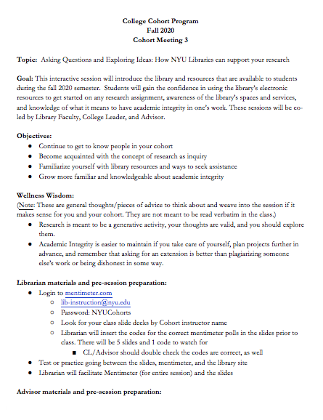

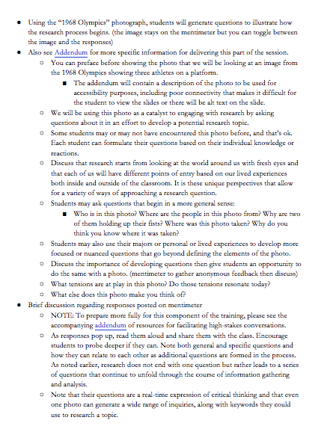

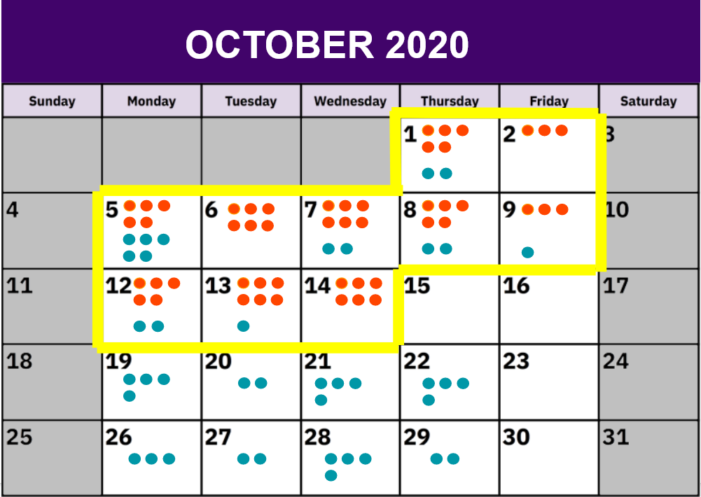
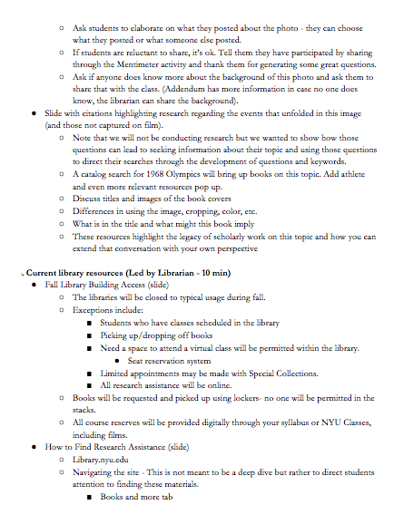
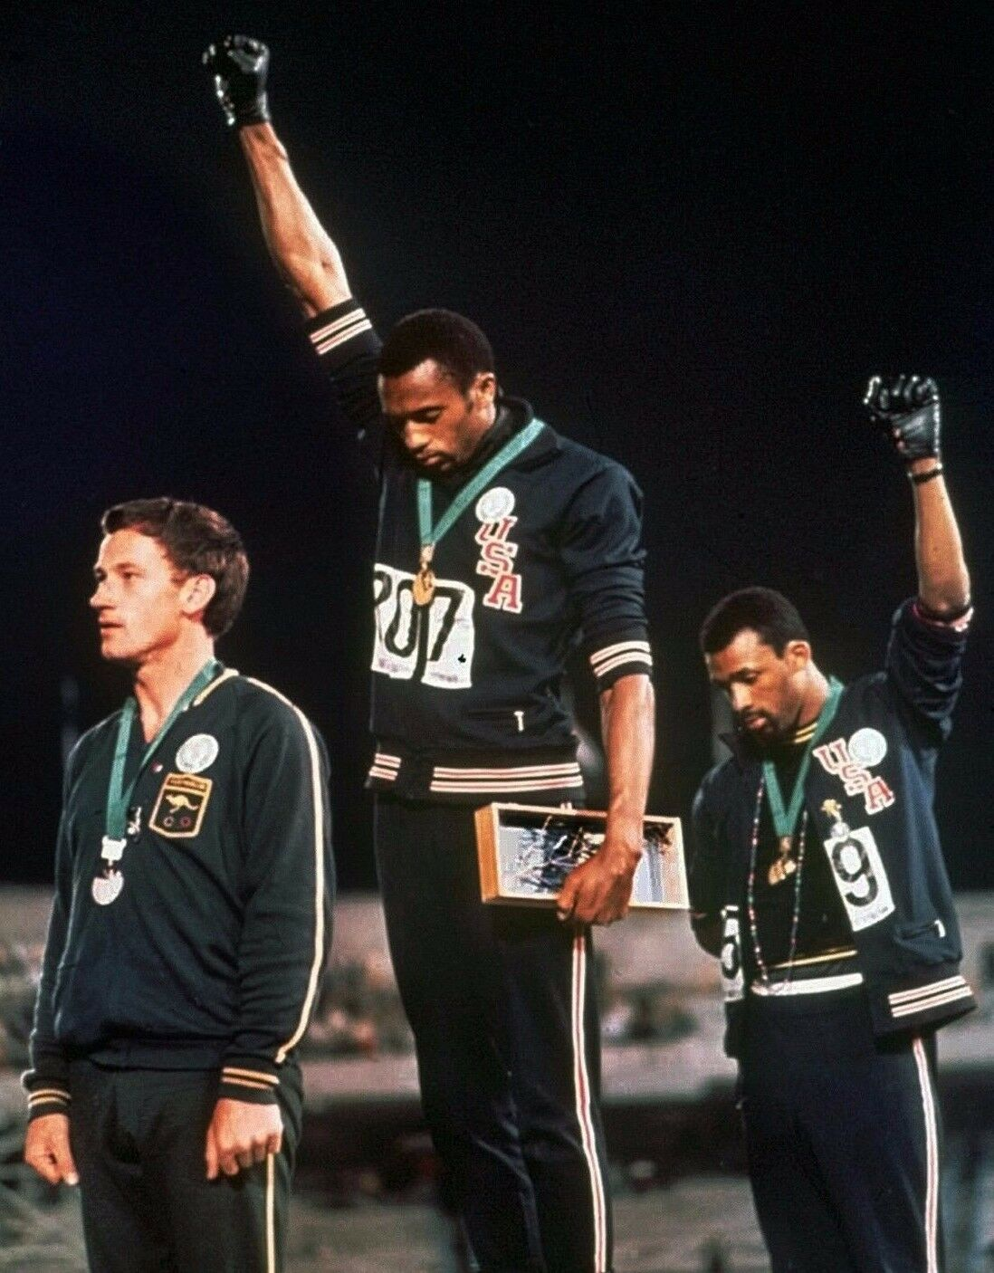
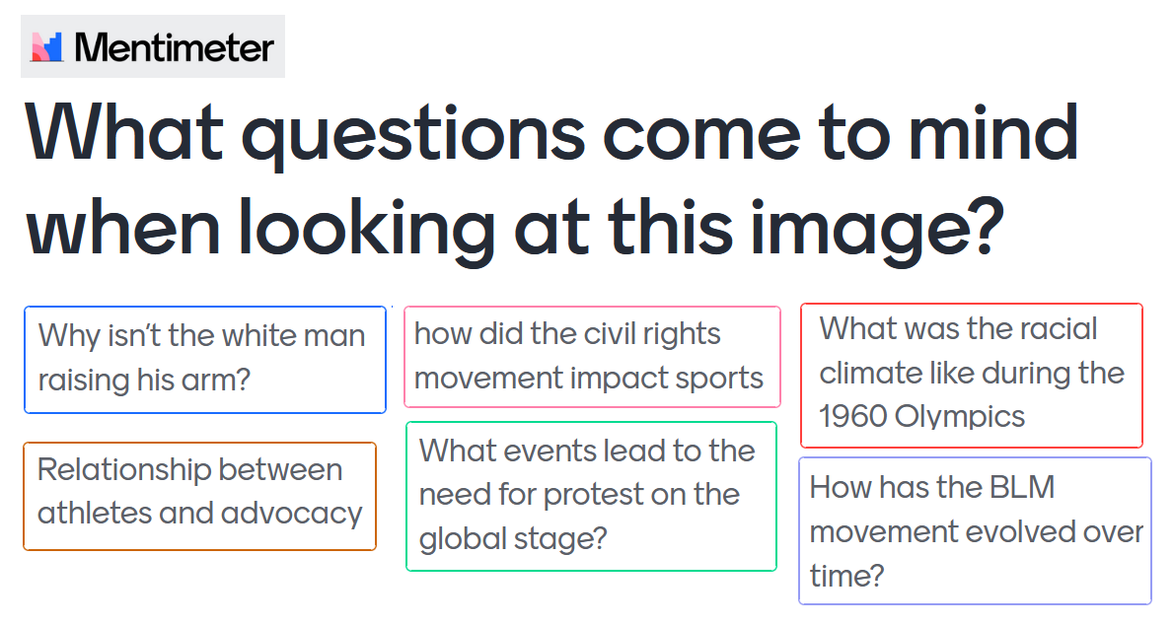

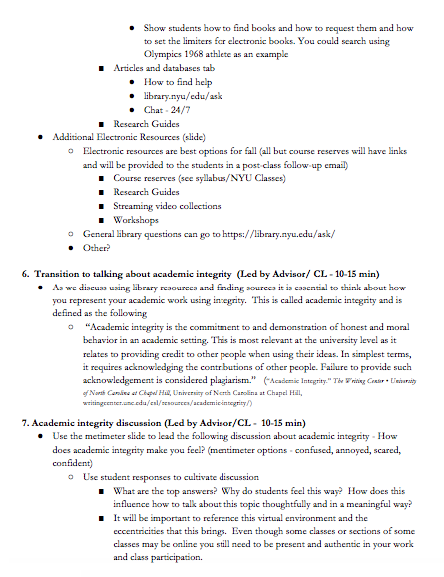
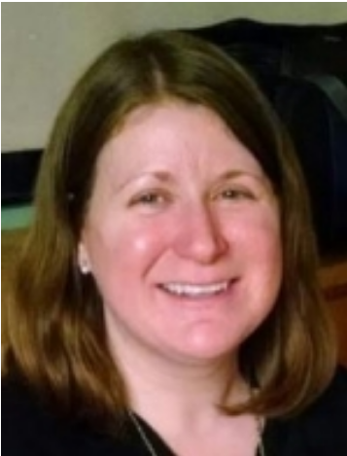






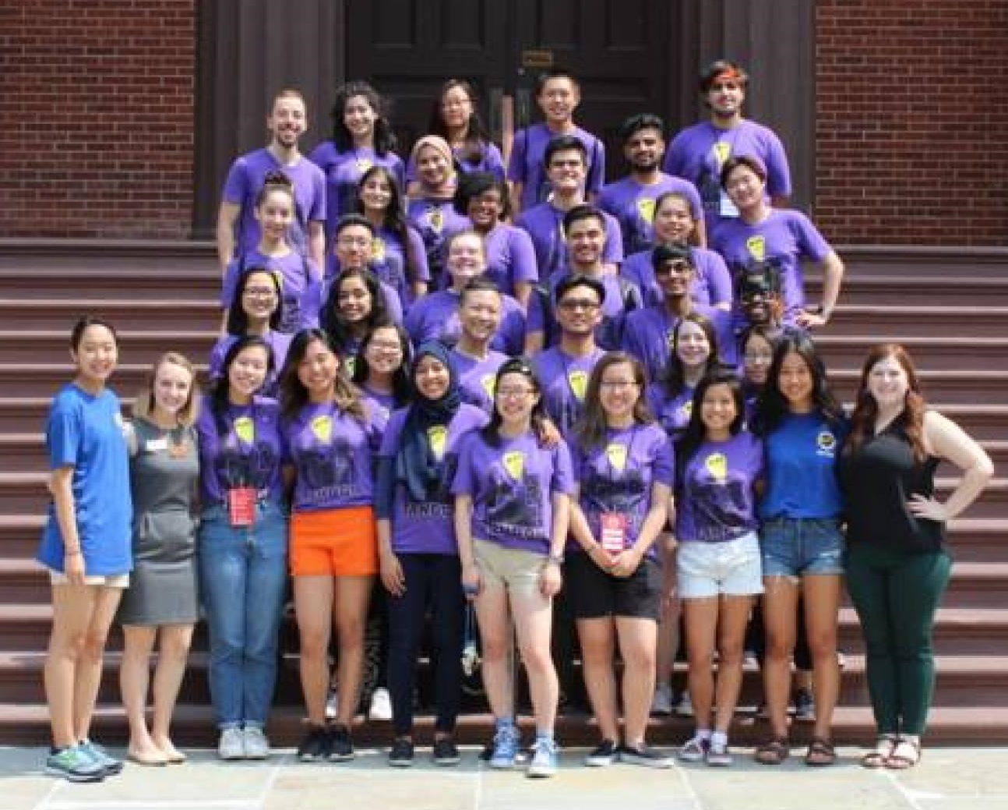
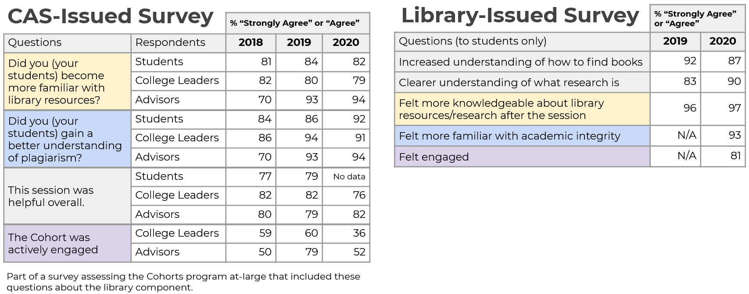
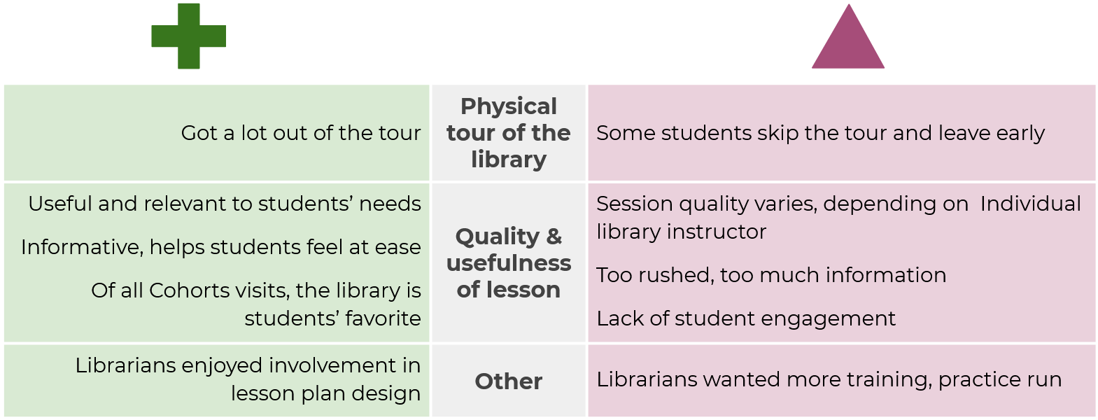

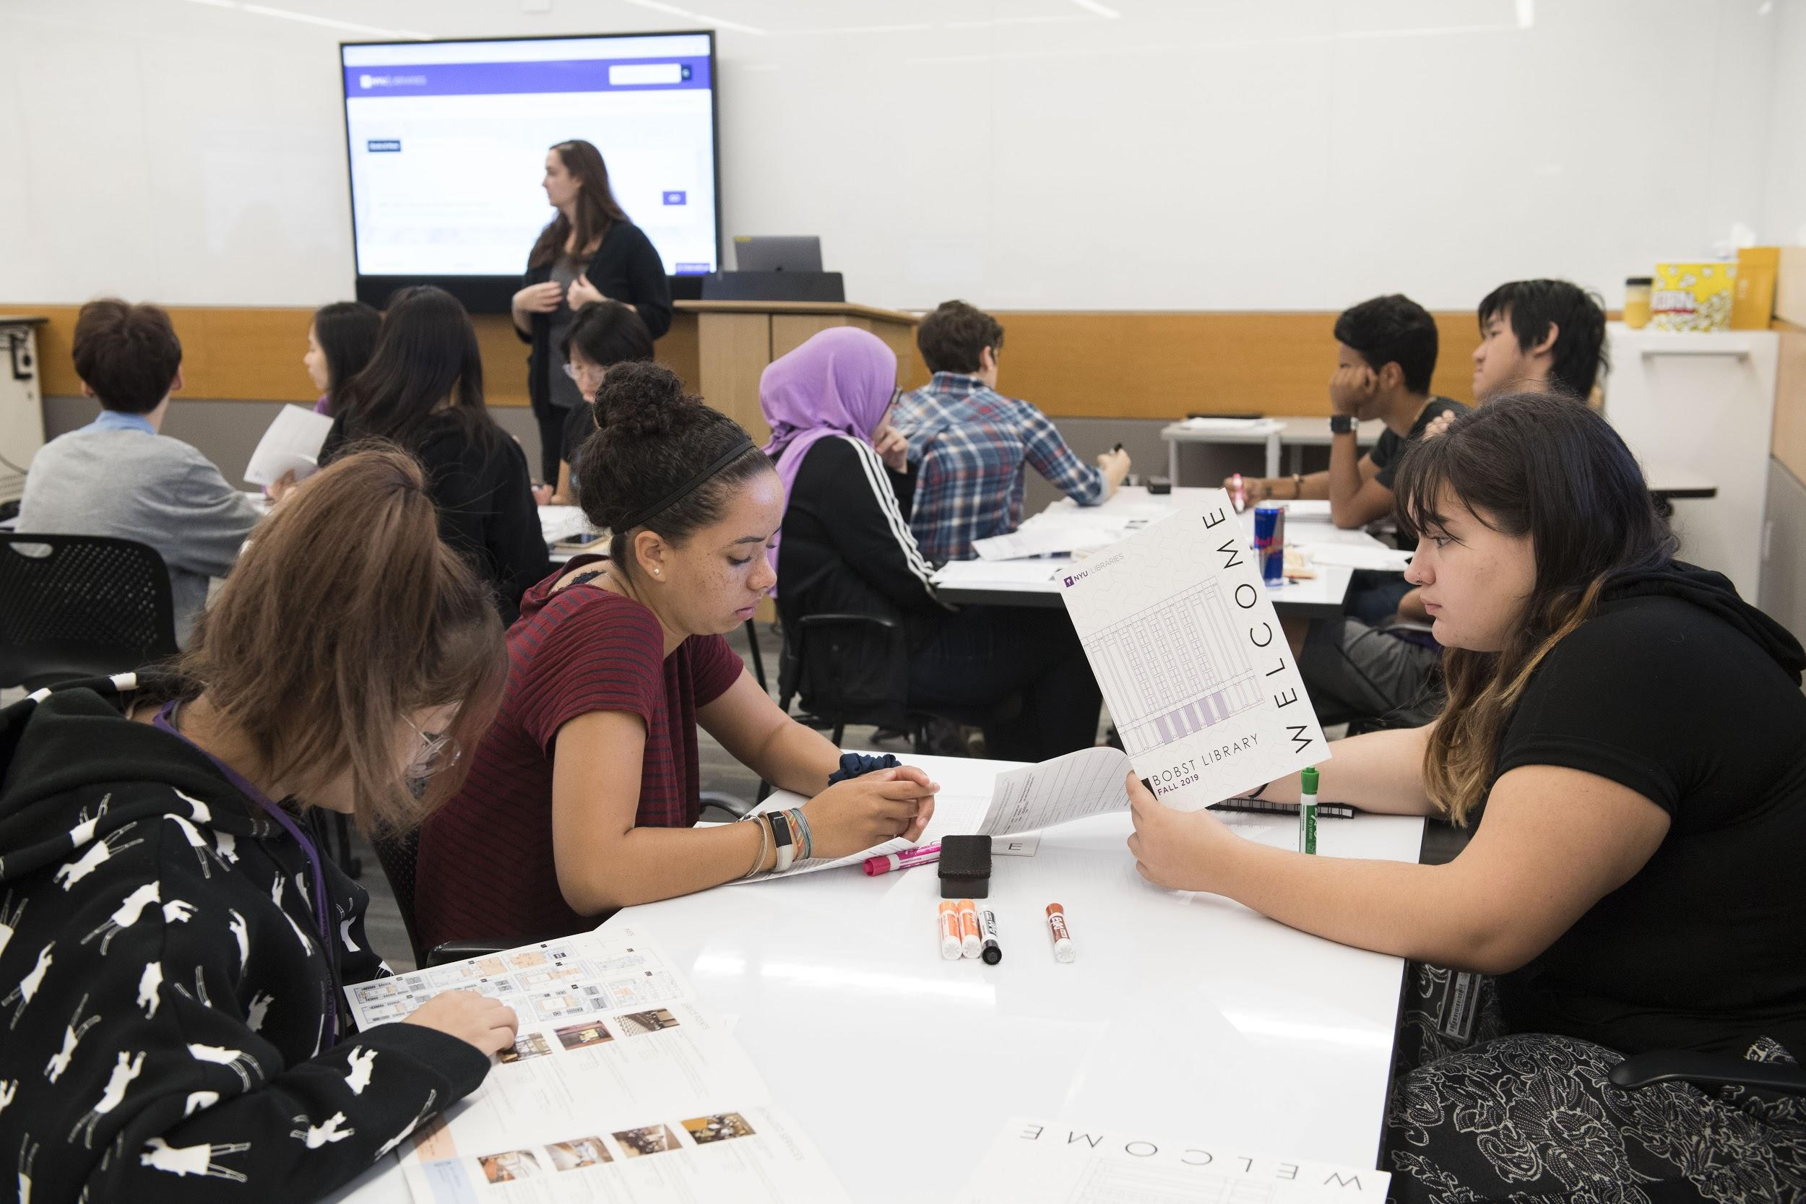

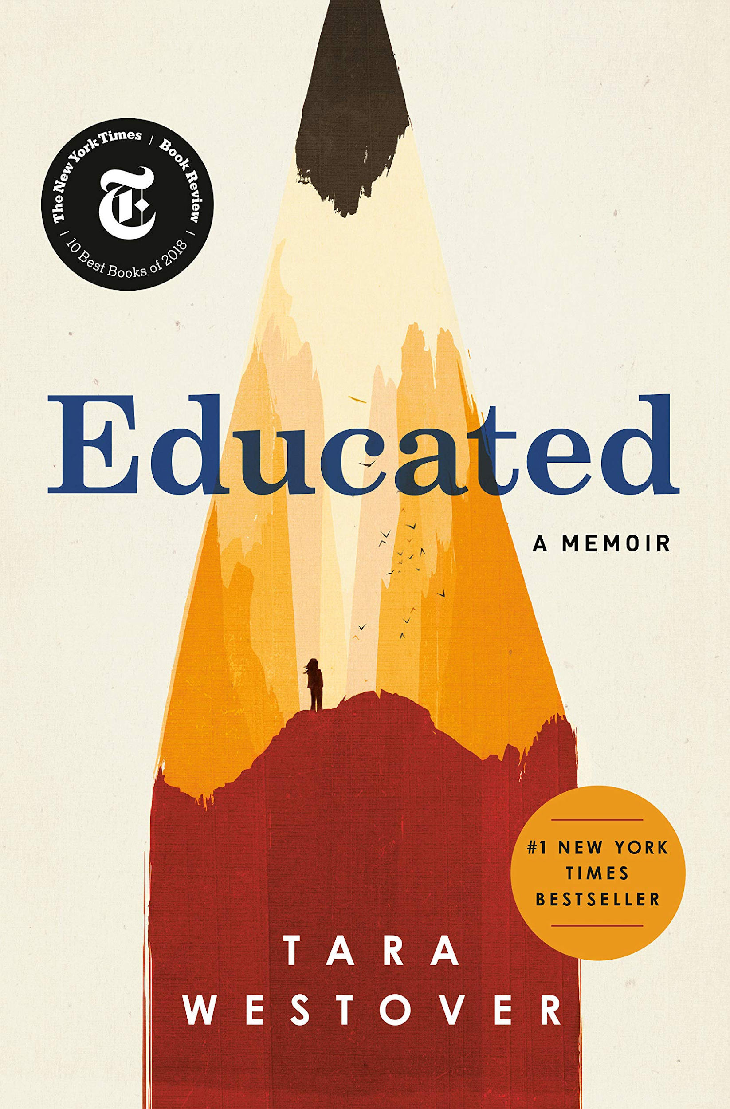
Embracing the Peaks and Valleys
Using Assessment Data to Redesign a First-Year Experience Library Session
Abstract
Planning & Logistics
Current Iteration Highlights
This poster describes how the library component of a first-year experience program was revised and optimized through data-informed design and considerations of accessibility and scalability. It illustrates:
How multiple streams of assessment inform the iterative process of developing a first-year experience library session
Strategies for collaborating with internal library and external stakeholders to optimize a first-year experience library session
Prioritization of accessibility and inclusion in session planning
COLLABORATION
SCALABILITY
IDBEA ELEMENTS
INCLUSION, DIVERSITY, BELONGING, EQUITY, ACCESSIBILITY
COLLEGE COHORT PROGRAM
UNDERGRADUATE & INSTRUCTIONAL SERVICES (UIS)
Cohorts by the numbers: We cover 50 sections in 10 days, taught by Core Instruction Team (3 UIS librarians + 5 reference/instruction associates) and 6 subject-specialists.
A “plug-and-play” lesson plan provides library instructors with complete, step-by-step guidance.
Assistant Dean Head of CCP
Student Leader Captain in CCP
Prof. First Year Writing Program
Created by Eucalyp from noun project
Head of UIS
UIS Librarian
UIS Librarian
The Library has been working with the Cohorts program since 2012. Each year the librarians in UIS collaborate with a team in CAS to review and revise the library component, informed by the previous year’s assessment data.
Covering so many Cohorts sessions at a busy time of the semester is challenging. Most sessions fall to the library’s Core Instruction Team, but a handful of subject librarians pitch in to teach some sections. UIS and CAS work together to design a complete “plug-and-play” lesson plan, which greatly minimizes library instructors’ prep time and keeps content consistent across all sections.
A priority across NYU is IDBEA: inclusion, diversity, belonging, equity, and accessibility. In the aftermath of George Floyd’s murder and similar incidents which led to widespread protest, we were intent on including a practical application of IDBEA into the library session. In parallel, our Cohort colleagues wanted to include a visual literacy aspect. We settled on using an iconic 1968 Olympics image to help students practice the process of generating research questions, using Mentimeter as our engagement tool. This allowed for a more in-depth and robust discussion of library resources while showing students how to take an historical topic and relate it to contemporary issues.
What is “Cohorts”
Assessment Data
COLLEGE COHORT
PROGRAM
QUANTITATIVE DATA
QUALITATIVE DATA SUMMARY
1. Academic Success
2. Personal & Career Development
3. Community Engagement
4. Leadership Experience
ACCESSIBILITY IMPROVEMENTS
Cohort = 1 adviser, 1 student leader, 30 students
The CAS survey is issued at the end of the fall, which means months have passed before respondents give feedback. The Library’s survey seeks immediate reactions at the end of each individual session.
Incorporating more accessibility practices into Cohorts has been a priority since 2019. When planning the physical library tours for Cohorts, the
The College Cohort Program is a first year experience program in NYU’s College of Arts & Sciences that acclimates students to college life and supports their retention and success. The CAS freshman class is large − 1500 students − so a major goal of the program is to enable peer-to-peer connection and belonging by putting students into cohort groups.
Engagement is an area of notable divergence between the CAS and Library surveys, making this a subject for future inquiry. The CAS survey seeks College Leaders’ and Advisors’ perceptions of student engagement during the library session, but doesn’t ask students whether they felt engaged. In 2020, the library asked this question of students and found that 81% of them felt engaged, whereas College Leaders and Advisors’ felt students appeared to lack engagement.
Accessibility & Accommodations Librarian added tour details that highlighted services and resources for individuals with disabilities − including identifying accessible restrooms, how to request that an item be pulled from the shelf, stopping at the adaptive technology labs, and distributing paper copies of the tour script. With the transition to the virtual environment, accessibility remained important. The Google Slides presentation was formatted for optimal accessibility, all cohort leaders were encouraged to share the slides with the students so they could follow along on their own screens, and image descriptions were provided for the visual elements of the presentation. Since the lesson centered around a visual exercise, accessible alternatives were available if students needed to access another format.
Library’s Role
Curricular Changes
Academic Success
Be introduced to NYU academic resources, including the University Learning Center and the Writing Center
Develop a knowledge base about key NYU library spaces and services.
Develop an understanding of the CAS academic integrity policy
Enroll in a First-Year Seminar, a small course that allows them to establish a relationship with a professor and their peers.
DATA-INFORMED, ITERATIVE LESSON DESIGN OVER 3 YEARS
LEARNING OBJECTIVES
2018 Lesson Design
2019 Lesson Design
Same learning objectives, different approaches
2020 Lesson Design
ACRL Frame: Scholarship as a Conversation
ACRL Frame: Research as Inquiry
LEARNING OBJECTIVES
ACRL Frames: Research as Inquiry & Authority is Constructed and Contextual
1. Become acquainted with the concept of the “scholarly conversation”
View “Joining the Scholarly Conversation” video from Kishwaukie College Library
In library classroom, students sit at tables of 4 and work in teams
1. Continue to get to know
people in your cohort
Zoom breakout room discussion: In what area are you an “unofficial expert”?
2. Get familiar with library databases
Exercise: Search ProQuest Central, noticing citation analysis feature
Common read as framing device for keyword brainstorming exercise
2. Become acquainted with the concept of research as inquiry
IDBEA*-related image as framing device for question-generating exercise
The library is built into the Cohort program’s Academic Success category. We provide a library session for each of the 50 cohort groups in the fall. Academic integrity is also an objective, and for the past few years we have inserted a discussion of plagiarism and student ethics into the library session.
3. Get comfortable navigating the building
Physical tour of the library
Physical tour of the library
3. Familiarize yourself with library resources and ways to seek assistance
*IDBEA = Inclusion, Diversity, Belonging, Equity, Accessibility
4. Grow more knowledgeable about academic integrity
Discussion of various plagiarism scenarios
Discussion of various plagiarism scenarios
4. Grow more knowledgeable about academic integrity
Demo of key areas of the Library’s website
Discuss strategies for avoiding situations (such as procrastination) that might tempt students to plagiarize
CONTACT INFORMATION:
Michelle Demeter
Head of Undergraduate & Instructional Services
michelle.demeter@nyu.edu
In 2018 our lesson was based around the ACRL Frame “Scholarship as a Conversation.” A review of the 2018 assessment data led us to reconsider whether this frame was the best fit for freshmen visiting the library for the first time. We decided to overhaul the 2019 lesson, basing it on the “Research as Inquiry,” Frame, a more grounding concept for new students.
Marybeth McCartin
Instructional Services Librarian
mm10@nyu.edu
Lauren Kehoe
Accessibility & Accommodations Librarian
Lauren.kehoe@nyu.edu

